Slide 1
EU Policy & its Impact on Ireland
Dr Alessandra Accogli
Teaching Assistant
DCU School of Law and Government

Slide 2
Agenda
Why the EU matters nationally
How EU Policy works
  Key EU actors
  Key EU legal acts
Case study: environmental and climate policy and peatlands
How can local people engage with EU policy

Slide 3
Basic Definitions
EU Legislation: Laws enacted by the institutions of the European Union that have an impact on the member states and their citizens.
Treaties: They are the foundation of EU law – called primary law. Two main treaties: Treaty on European Union (TEU) and the Treaty on the Functioning of the European Union (TFEU).

Slide 4
Why the EU matters nationally

Slide 5
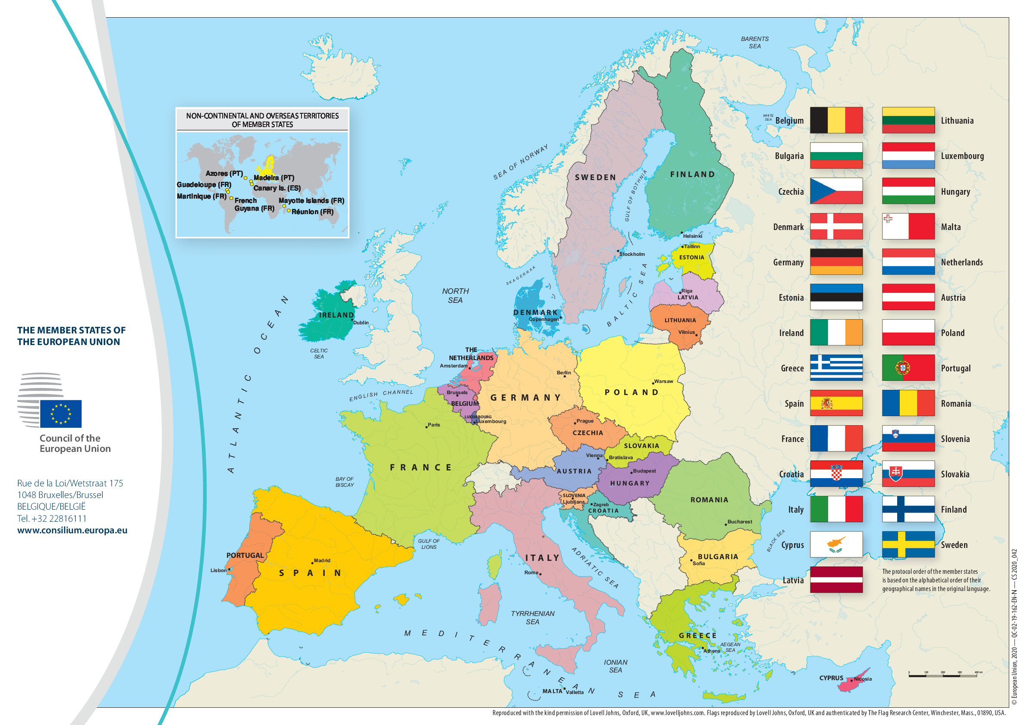
Where do you think most of Ireland’s rules come from?
In 1988, Jacques Delors, then President of the EU Commission, predicted that within a decade 80% of national policymaking would originate from the EU
However, any figure is debatable
Source: Deirdre Halloran, ‘Understanding EU law’ (Houses of the Oireachtas)

Slide 6
Distribution of competences between EU and Member States
3 Categories of Competences:
Exclusive Union competence: in the areas indicated in the treaty, only the EU may legislate and adopt legally binding acts
Shared competence: in these areas, both the EU and member states can legislate. However, member states may only exercise their own power if the EU has chosen not to exercise its competence
Supporting competence: In these areas, the EU's role is strictly to back up, coordinate, or supplement the policies of the member states.
Source: Marcus Klamert, The Principle of Loyalty in EU Law (OUP 2014)
Notes:
Member States cannot regulate in areas that fall under the exclusive competence of the Union unless they are specifically authorized to do so

Slide 7
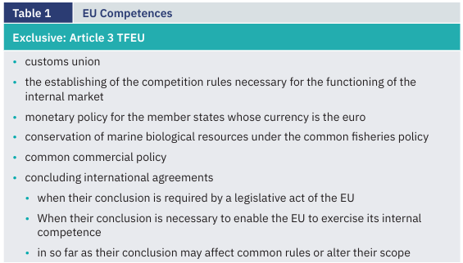
Source: Deirdre Halloran, ‘Understanding EU law’ (Houses of the Oireachtas)

Slide 8
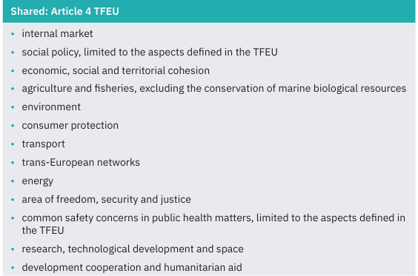
Source: Deirdre Halloran, ‘Understanding EU law’ (Houses of the Oireachtas)

Slide 9
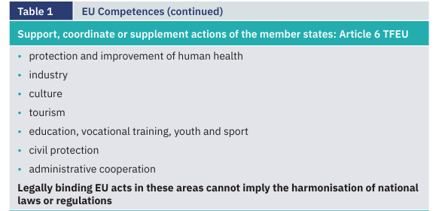
Source: Deirdre Halloran, ‘Understanding EU law’ (Houses of the Oireachtas)

Slide 10
Where do you think most of Ireland’s rules come from?
In some areas, the EU tends to heavily influence certain policies while other areas are left for Member States to decide on
There are policy areas with high shares of ‘Europeanised’ laws, e.g. agriculture, environment
There are also policy areas with lower shares of laws coming from the EU, e.g. employment, health
Source: Sophia Khatsenkova, ‘Fact-check: Does the EU decide 80% of our laws?’ (Euronews, 22 March 2024)

Slide 11
How EU Policy works

Slide 12
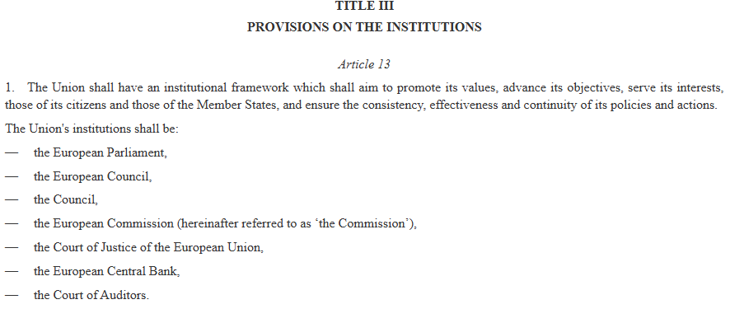

Slide 13
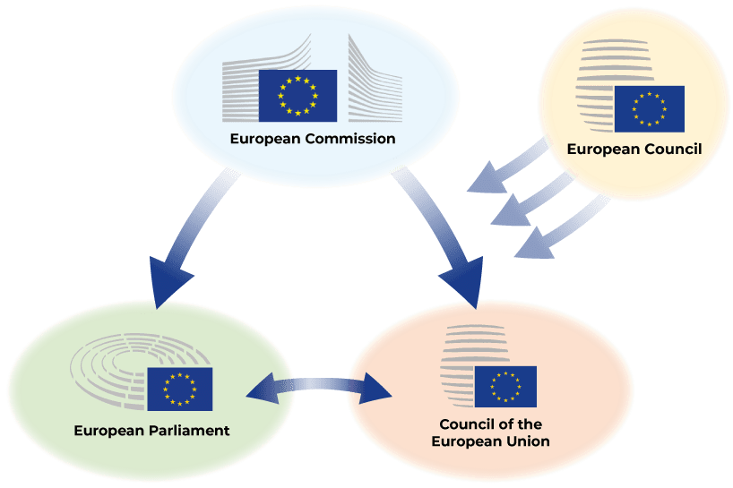
EU key institutions

Slide 14
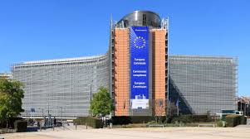
European Commission
Role: Art 17 TEU – The Commission shall
  promote the general interest of the Union and take appropriate initiatives
  ensure the application of the Treaties and oversee the application of Union law
  execute the budget
  ensure the Union's external representation
Union legislative acts may only be adopted on the basis of a Commission proposal
Members: 27 commissioners – one per MS - whose independence is beyond doubt
Location: Brussels
Notes:
President: proposed by the European Council and elected by the Parliament; she/he shall: lay down guidelines; decide on the internal organisation of the Commission, ensuring that it acts consistently, efficiently and as a collegiate body; appoint Vice-Presidents

Slide 15
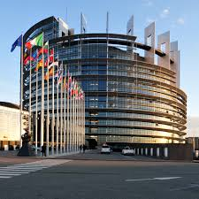
European Parliament
Role: Art 14 TEU – The Parliament shall
  exercise legislative and budgetary functions (jointly with the Council of the EU)
  exercise functions of political control and consultation
  elect the President of the Commission
Members: composed of representatives of EU citizens, who shall not exceed 750, plus the President. Representation is degressively proportional, with a minimum of 6 members per Member State (Ireland: 14 MEPs)
  Elected for a 5-year term
Location: It splits its operations between three cities: Strasbourg, France (official seat, plenary sessions); Brussels, Belgium (committee meetings, political groups); and Luxembourg (secretariat)

Slide 16
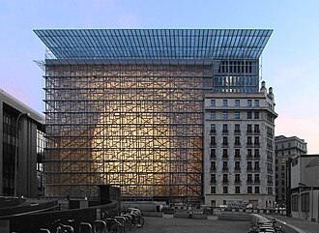
European Council
Role: It shall define the general political directions and priorities of the Union. It shall not exercise legislative functions (Art 15 TEU). Does not adopt EU Laws, except EU Treaty amendments
Members: It consist of the Heads of State or Government of the Member States, together with its President and the President of the Commission
Meetings and location: EU leaders (heads of states / governments) meet 4 times a year in Brussels
Notes:
President: European Council’s President prepares and drives the work (continuity)
Elected for 2,5 years, renewable once

Slide 17
Council of the EU
Role: represents governments at ministerial level, exercises legislative and budgetary functions (jointly with EP) and coordinates EU policies (Art 16 TEU)
Members: a representative of each Member State at ministerial level (government ministers)
President: Each EU country holds the presidency on a 6-month rotating basis
Established in: 1958 (as Council of the European Economic Community)
Meetings and location: Council meetings take place in Brussels, except for three months (April, June and October) when they are held in Luxembourg
Notes:
Ministers from each member state meet to hash out common positions, usually in Brussels. Sometimes they need to agree by consensus, sometimes a majority vote will do.
Finance, foreign affairs and agriculture ministers gather for EU council meetings about once a month, others less frequently. Health and education ministers are a rarer sight, because the EU does not have as much remit to set common policy in those fields

Slide 18
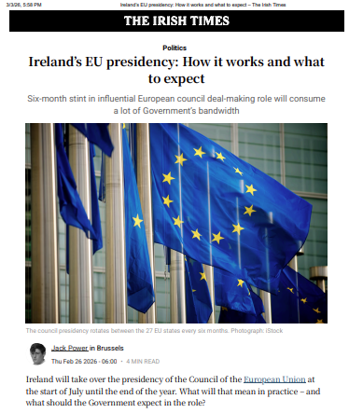
Ireland’s presidency of the Council of the EU
Notes:
Source: https://www.irishtimes.com/ireland/2026/02/26/irelands-eu-presidency-how-it-works-and-what-to-expect/
The chair is meant to focus on the broader EU agenda, rather than their own narrow national interest.
Ireland will be expected to get all 27 governments to agree on the size and shape of the EU’s next seven-year budget by Christmas.
Ireland will be expected to drive forward EU efforts to increase the amount countries spend on defence and their militaries. Developments in the Ukraine war and volatile relations between Europe and the Trump administration will no doubt feature heavily. Ireland believes it can act as something of a bridge between Brussels and Washington, according to a confidential early draft of its priorities for the EU role. A peace deal in Ukraine would have massive ramifications for the future security of Europe, for better or worse depending on the terms of any settlement.

Slide 19
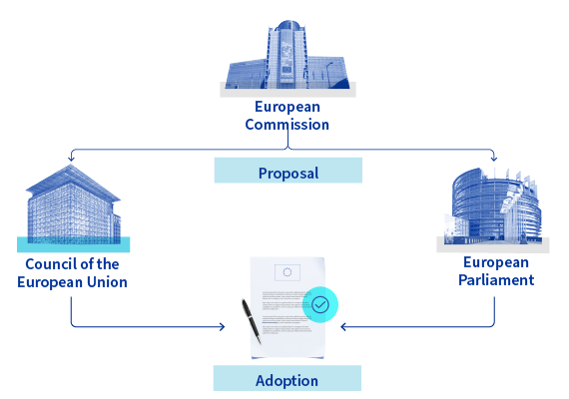
EU legislative process
Notes:
An EU legislative act normally starts as a “proposal” from the Commission
The text of the Commission’s proposal forms the starting point of all subsequent negotiations between the European Parliament and the Council
Any suggestion for a change to the Commission proposal must be presented in the form of a textual amendment
Art 289(1) TFEU: The OLP shall consist in the joint adoption by the European Parliament and the Council of a regulation, directive or decision on a proposal from the Commission
European Parliament is a co-legislator with the Council
This procedure is the most widely used method of EU decision-making: covers most EU's areas of competence
Special Legislative Procedures: An exception from the ‘ordinary’ legislative procedure
Council in practice the sole legislator
More sensitive policy areas, importance of national sovereignty E.g. foreign policy, immigration and justice
In this procedure, the Parliament is asked for its (non-binding) opinion or consent on proposed legislation before the CM adopts it

Slide 20
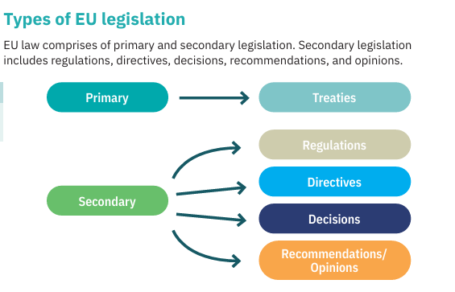
Key legal acts
Source: Deirdre Halloran, ‘Understanding EU law’ (Houses of the Oireachtas)

Slide 21
EU secondary legislation
Regulations: Binding legislative acts that apply directly in all Member States without needing to be transposed into national law (e.g. Nature Restoration Law)
Directives: Legislative acts that set out objectives that Member States must achieve. However, Member States have some flexibility in how they implement these objectives into their national law (transposition) (e.g. Habitats Directive)
Decision: A decision which specifies those to whom it is addressed shall be binding only on them
Recommendations and Opinions: Non-binding acts issued by EU institutions. They only express a view on a particular issue. Do not create legal obligations
Binding
Notes:
Regulation: has general application, binding in its entirety and directly applicable in all Member States.
Directive: binding, as to the result to be achieved, upon each Member State to which it is addressed, but leaves to the national authorities the choice of form and methods.
Decision: binding in its entirety. A decision which specifies those to whom it is addressed shall be binding only on them.
Recommendations & Opinions: no binding force.

Slide 22
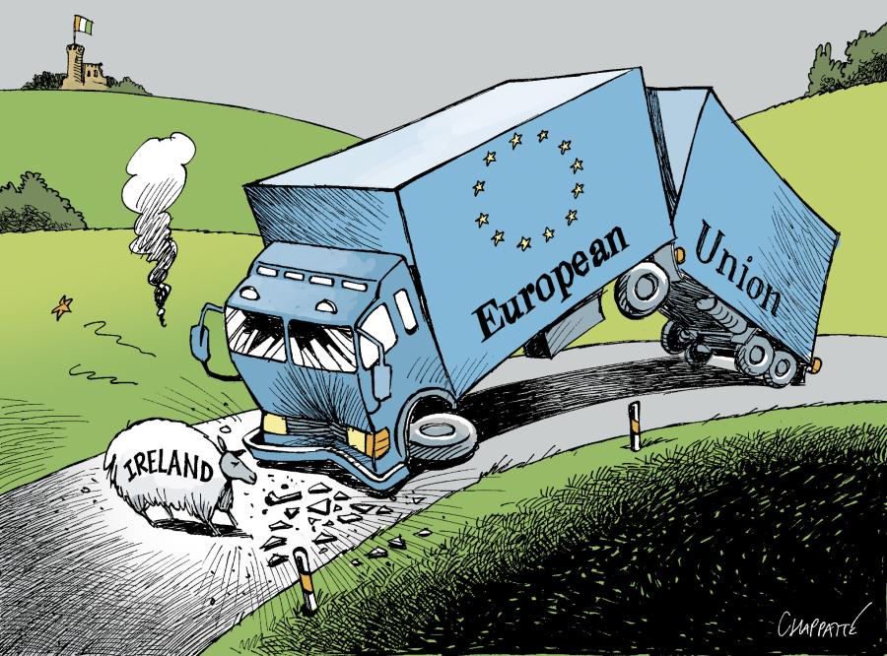
How EU policy impacts Ireland
EU law - provided for by EU Directive - is transposed into Irish law
Implemented by:
  Agencies (e.g. NPWS responsible for managing nature conservation)
  Local authorities, e.g. through planning decisions
Experienced at local level through:
  Planning approvals: Environmental checks on local housing and infrastructure
  Local restrictions: Rules protecting drinking water, bogs, and wildlife habitats
  Community funding: Direct access to EU grants for rural and town development

Slide 23
Case study: environmental and climate policy and peatlands

Slide 24
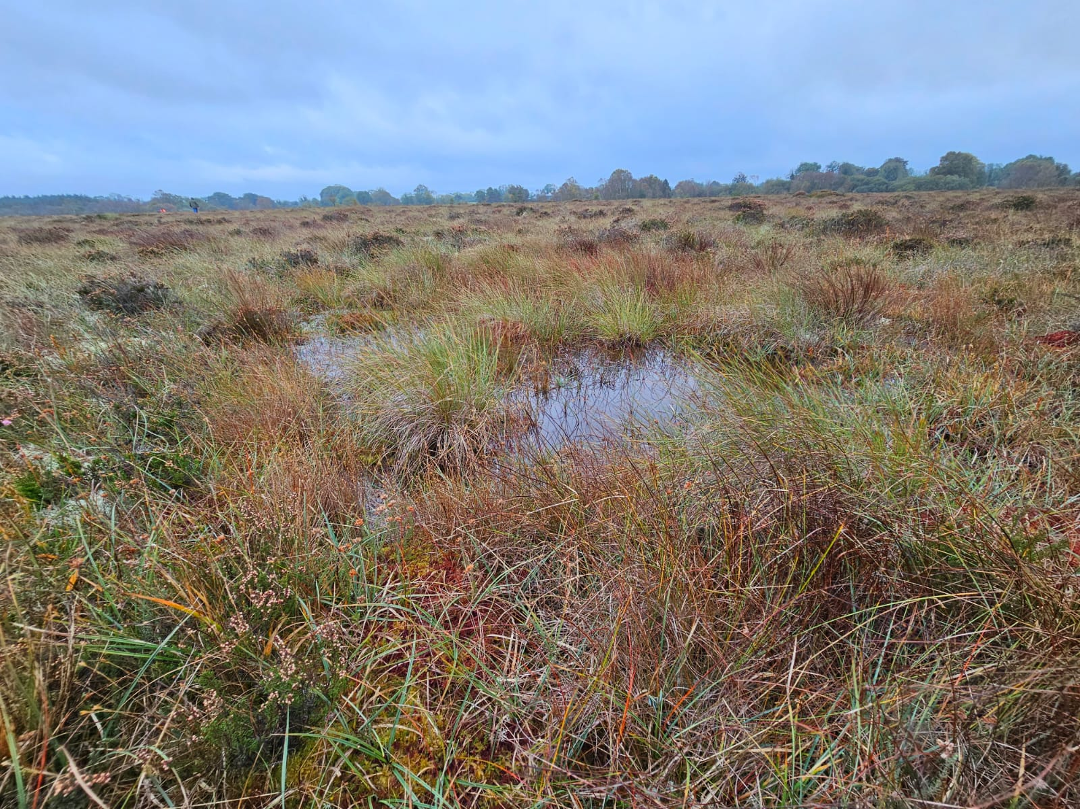
EU level
Environmental policy
E.g. Habitats Directive (1992): asks Member States to designate ‘special areas of conservation’ (SACs) to maintain or restore them to a ‘favorable conservation status’
Active and degraded raised bogs as well as blanket bogs are among the habitat types listed in Annex I of the Habitats Directive which means that they must be designated as SACs
Once sites are designated, Member States have then obligations to conserve sites
Source: Photo from a field trip (Ireland, October 2023)

Slide 25
Irish level
Environmental policy
The Habitats Directive was transposed into Irish law in 1997 by regulations that were then consolidated into the European Communities (Birds and Natural Habitats) Regulations in 2011
National Parks and Wildlife Service (NPWS) is the responsible agency appointed for implementing the Habitats Directive in Ireland
Ireland has designated 55 SAC sites for the conservation of active raised bogs and 55 SAC sites for the conservation of blanket bogs
Source: Photo from a field trip (Ireland, October 2023)

Slide 26
Irish level
Different stages of site designation in Ireland:
Site identification is conducted on the basis of the criteria laid out in Annex III of the directive using pre-existing knowledge in Government’s hands, various publications, ongoing surveys and site visits by NPWS, as well as contributions from NGOs
Once the sites are identified any landowner is notified directly of the inclusion of the land in a list of candidate sites
Any person with an interest in the site is allowed a 3-month period to lodge an objection to a proposed designation, which can be assessed on scientific grounds only
Finally, the site is designated as SAC giving rise to the obligations set out in the Habitats Directive
Source: Photo from a field trip (Ireland, October 2023)
Notes:
It follows that Member States have a certain degree of discretion in identifying the most representative peatland sites
Ireland has failed to designate 217 of the SCIs, of which 20 are raised bogs. Given the large number of privately owned lands among the areas designated as SACs, Ireland relied on the complexity of the formal designation process which can result in the need to engage with thousands of landowners individually and to handle hundreds of appeals filed by them.49 The CJEU did not however accept this argument, recalling that ‘Member States cannot plead provisions, practices or situations prevailing in its domestic legal order to justify failure to observe obligations arising under EU law’.

Slide 27
Irish level
Obligations to conserve sites under Habitats Directive translated into restrictions on peat extraction, both domestic and industrial, on designated sites
Source: Photo from a field trip (Ireland, October 2023)

Slide 28
EU level
Climate policy
E.g. European Climate Law (2021): it establishes climate goals, such as the target of GHG emission reduction of at least 55% by 2030 compared to 1990 + climate-neutrality objective by 2050
E.g. Nature Restoration Law (2024): it establishes legally binding restoration targets for degraded ecosystems, including peatlands, ‘at least 30% of the total area of all habitat types’ in need of restoration by 2030
Source: Photo from a field trip (Ireland, October 2023)

Slide 29
Irish level
Climate policy
Phasing out of peat for energy production
Cessation of industrial peat extraction by Bord Na Mona due to the Irish Government’s decision to stop using peat in peat-fired power plants by 2030 in light of climate commitments
Bord Na Mona transition to peatland restoration
Source: Photo from a field trip (Ireland, October 2023)
Notes:
Specifically, the national planning authority decided in 2019 to refuse permission to implement certain modifications in the two peat-fuelled power plants owned by ESB
ESB decided to stop using peat in these plants as early as the end of 2020, which led to BNM’s consequent withdrawal from peat extraction on an industrial scale, impacting workers in the industry

Slide 30
Irish local level
Climate policy
Impact on workers in the peat industry, e.g. job losses
Community adaptation
New funding opportunities, e.g. National Just Transition Fund
Source: Photo from a field trip (Ireland, October 2023)
Notes:
The National Just Transition Fund is, for instance, a key pillar of the Government’s plan to support local and community-led projects with a view to creating alternative employment opportunities and reskilling workers to engage with the green economy

Slide 31

Interactive exercise (10 min)
Identify one issue in your community
Discuss with your peers:
  Is there an EU dimension?
  How can you intervene?

Slide 32
How can local people engage with EU policy

Slide 33

Public participation
Engage at local level
  Planning applications
Engage at national level
  National public consultations
  Direct Lobbying
Engage at EU level
  Public consultations by the EU Commission
  NGOs / umbrella organisations
Notes:
Engage at local level
Planning applications: EU law guarantees your community the legal right to access environmental information and object to local planning decisions that breach EU rules
Engage at national level
National public consultations: every EU directive must undergo a national public consultation before it becomes Irish law
Direct Lobbying: Use national advocacy groups (like the Irish Rural Link or environmental networks) to voice community concerns directly to TDs and Ministers.
Engage at EU level
Public consultations by the EU Commission: Have your say via the EU's online "Have Your Say" portal during the early drafting stages of new European laws.
NGOs / umbrella organisations: Team up with European-level networks that pool the voices of local community groups to lobby directly in Brussels.

Slide 34
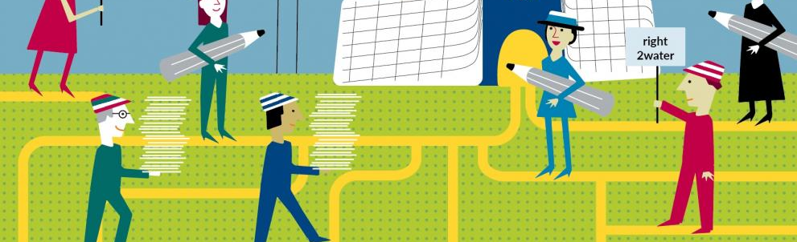
Conclusions
EU policy is not distant
Depending on the policy area, EU law can shape significantly local decisions
Local people are not powerless, but can participate through various ways

Slide 35
Thank you!
Dr. Alessandra Accogli
E: alessandra.accogli@dcu.ie

