Slide 1
Effective Meetings and Committee Skills
Adrienne Collins
Notes:
Phones silent and out of sight

Slide 2
Learning Outcomes
Identify documents that would help you to understand your organisation better
Describe the roles of committee members, in particular the ordinary member
Describe the purpose of meetings
Describe the importance of agendas and minutes
Prepare well for a meeting
Recognise whether a meeting is effective or not
List resources to support effective meetings and committee skills

Slide 3
Induction of Committee Members
Aims and objectives of group
Most recent annual report
Minutes of last 2 or 3 meetings
Dates of upcoming meetings
Strategic plan/development plan/workplan
Financial report, budget for year, funding sources and requirements
History of the organisation, legal status
Notes:
Governance code, register re lobbying, fundraising code, SORP

Slide 4
Further induction materials
Material appropriate to role – staff liaison officer should have access to job descriptions; treasurer should have access to accounts
Recent newsletters or publicity material
Committee structure, including roles and sub-committees
Information on the programmes/ members/service users
Notes:
History of org
Eval rpt

Slide 5
Role of Ordinary Member
To prepare in advance of the meeting
To attend, on time
To participate at the meeting – listen, ask questions, speak, support other board members
To take on a role in organisation
To volunteer to do work between meetings and to do it
To represent organisation in positive way
Notes:
Put your mobile phone on silent and out of sight …….
Ambassador for org, should actively promote it wherever possible
What do I feel about being on the committee?
What experience do I bring?
What skills do I bring?
Think before you speak, get Chair’s attention, be as brief as you can, speak assertively
Play your part in maintaining the group
Task and process of committee work
Take initiative to make things better in difficult meeting
An effective committee will know – see doc

Slide 6
Role of Chairperson
Plan meeting
Manage meeting, time, ensure decisions are made, staying as impartial as possible
Summarise decisions
Ensure decisions are implemented
Liaise with staff (or most senior staff in larger organisation)
Represent the organisation externally
Notes:
Try to involve everyone
Listen most of the time
Good to have timed agenda and stick to it

Slide 7
Role of Secretary
To prepare agenda with chairperson
To circulate agenda and supporting papers
To book meeting room
To take, write up and circulate minutes (after chairperson has reviewed them)
To ensure chairperson signs approved minutes
To deal with correspondence
File agenda, minutes and meeting documents in hard copy and electronically
Keep membership details up to date
To inform/remind people of next meeting
Notes:
Comply with duties imposed by Companies Registration Office, CRO
Annual Return and Financial Statement Requirements – Leaflet No 23, September 2017, CRO
The Directors of a company must familiarise themselves with the company’s obligations to keep adequate accounting records
If Financial Statements are not completed correctly and filed on time, the company and every officer of the company who is in default shall be guilty of a category 3 offence.
Need to submit material to Charity Regulator and to CRO
Annual Return 2. Filing an Annual Return Electronically 3. Financial Statements 4. Audit Exemption 5. Auditor’s Report 6. Certification of B1 & Financial Statements 7. Revision of Financial Statements and/or Directors’ Report
Co Sec – registers up to date, AGM held within 18 months, then within 15 months, proper notice of AGM, call general meetings acc to rules, keep minutes’ books, make sure accounts prepared & audited (with treasurer), send in annual return to CRO by annual return date, keep copies of annual returns & accounts, notify CRO re change of directors/addresses, ensure cert of incorporation is displayed, name of org displayed outside, co name & reg no & director details on letterhead, notify CRO of amendment to memo & arts, make sure legal agreements discussed & agreed & kept safe, comply with CRO duties

Slide 8
Role of Treasurer
Oversee, present and approve budgets, accounts and financial statements
Prepare and present clear reports to board
Ensure financial resources meet needs
Ensure accounting procedures and controls are in place
Liaise with staff/volunteers re financial matters
Advise on financial implications of new projects or activities
Notes:
Comply with CRO & Charity Regulator requirements

Slide 9
Sub-committees, working groups, additional roles
Sub-committee – ongoing
Working group – time-limited, for specific project
Opportunity to bring in additional expertise and resources
Need approval of board, clear terms of reference including reporting relationship
Consider possible additional roles on the committee of vice-chairperson, staff liaison officer, volunteer co-ordinator
Notes:
Roles – admin, fundraising, PR, HR, service delivery – useful to have written role description

Slide 10
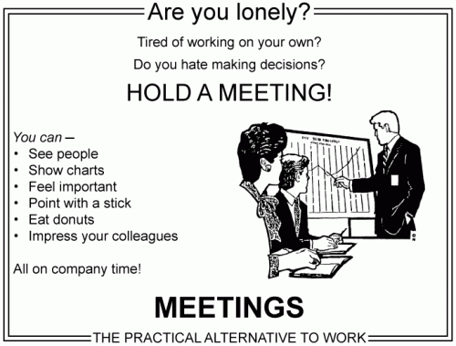

Slide 11
Overview of Meetings
Giving information
Receiving information and advice
Negotiating
Progressing projects
Solving problems
Making decisions or consulting colleagues / others
To allow people to air their grievances

Slide 12
Purpose of agenda
To enable participants to prepare
To ensure everything important is dealt with
To guide through subjects in logical order
To remind chairperson what to discuss
To make chairing easier, all aware of structure and order
To give structure to the minutes
(Based on Taking Minutes of Meetings, J Gutman, The Sunday Times)
Notes:
Title of group / meeting
Date, time and venue of meeting
Minutes of last meeting
Matters arising from the minutes
Committee business, if necessary
Correspondence
Financial report
Issue for discussion (submitted in advance)
Issue for discussion (submitted in advance)
Any other business
Date of next meeting

Slide 13
(From The Wheel: Sustainable Communities – Governance Guide)
AGENDA FOR MEETINGS OF THE GOVERNING BODY TEMPLATE
Organisation:
Time & Date:
Venue:
Item |  | Time needed (minutes) | For information? For discussion? For approval? For action?
1 | Welcome and agenda review
2 | Present and apologies
3 | Minutes of previous meeting |  | For approval
4 | Matters arising not covered elsewhere on the agenda
5 | Financial report |  | For discussion
6 | Report from
7
8
9 | AOB
10 | Next meeting |  | For action
1.5 hours TOTAL
Notes:
Samples

Slide 14
Purpose of Minutes
Record what happened
Inform people who were absent of what went on
Remind participants what actions they need to take
Show the process which led to the decision
Reference tool for future meetings to refer back to
Official record of decisions taken
Legal requirement (in organisations governed by company or charity legislation)
Support organisation’s good governance
Notes:
Record what happened. Aim to get the gist of a discussion, information points and decisions (record the message, not the words)
Reference tool for future meetings to refer back to – resolve disagreements, remind people of decisions
Name of group
Description of meeting
Date (including year)
Place
Members present (including surnames)
Any others present and in what capacity
Who chaired and who took the minutes
Apologies for absence
Corrections to previous minutes
Matters arising
Declaration of interest
Committee business
Reports /updates/ information items
Separate minute for each item, as on agenda
Any other business
Date, time and place of next meeting

Slide 15
Which meeting would you prefer?

Slide 16
Effective Meetings
Is there good attendance?
Does everyone participate and feel involved?
Is atmosphere lively, constructive, open and friendly?
Are decisions well made after sufficient discussion?
Are tasks distributed equally?
Are decisions follow up on?
Do people leave with a feeling of satisfaction?
Managing Together, Jane Clarke, CPA
Notes:
Is each meeting needed?
Are appropriate people going?
Are approp issues being dealt with?
Are some issues better dealt with outside meeting eg set up sub-group

Slide 17
Decision Making
Clarify issue and state it clearly
Give all relevant information
Express opinions
Encourage others to express opinions, see differences of opinion as helpful
Bring together all suggested solutions/courses of action, build on points of agreement
Discuss solutions and possible consequences
Make firm proposals
Make decision and record it
Put decision into action
Managing Together, Jane Clarke
Notes:
Consider working on decisions in small groups to encourage participation
Focus on issue, not on the person
Dealing with problems
Nobody says anything
People have side conversations
One person dominates
The discussion is going round in circles
A row breaks out
There is a cool or hostile atmosphere
Unease about the effectiveness of meetings
Running Effective Meetings, Carmichael Centre leaflet
Agreed process re putting items on agenda
Clear about issue – detailed info, fair and open discussion
Chair should test agreement before decision
Strong disagreement can be recorded, but all Board members are bound by the decision of the Board
Agreed process for decision making between meetings – if delegated to sub-comm, board sets parameters

Slide 18
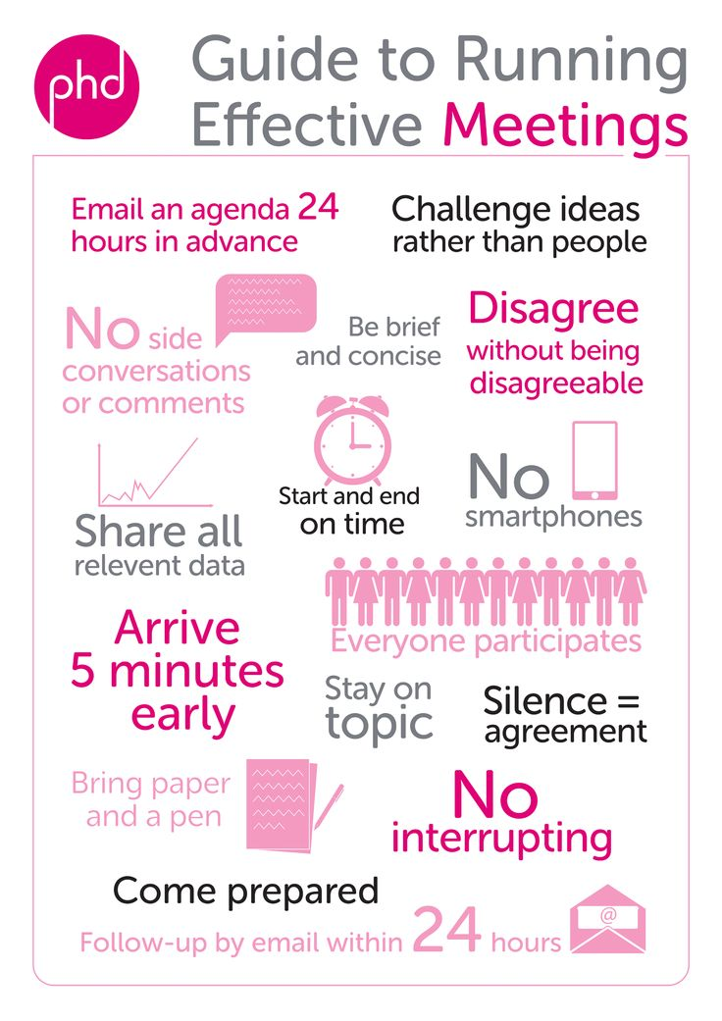

Slide 19
How to run an effective non-profit board meeting: https://youtube/t94SNWJ9EAo
Running Effective Meetings leaflet - Carmichael Centre
Roles and Responsibilities of the Board leaflet – Carmichael Centre
Tips for running effective board meetings – Carmichael Centre
Sustainable Communities: A Governance Resource Book for Small Community and Voluntary Organisations, The Wheel

Slide 20
Just About Managing? Sandy Adirondack, 2006
Managing Together – A Guide to Working Together as a Committee (1993, Jane Clarke, Combat Poverty Agency (CPA), pdf available online)
Developing Facilitation Skills, 2008, CPA
Good induction/mentoring
Solid Foundations series, The Wheel
Notes:
Lots of templates in Sustainable Communities
Local induction, talk with other board members

