Slide 1


Successful Grant Applications
Evelyn Fitzpatrick
Evelyn Fitzpatrick Consulting
26 March 2025

Slide 2

Presentation will cover
How to access Grants /Funding.
Grants available.
Tips for successful Application.
What Funders look for.
How Applications are assessed.
Characteristics of a Winning Proposal.
Rules for writing grant applications.
READ …Grant Application forms.
How to measure value of Voluntary work.
How work is measured – Outcomes.
Why applications fail.
Why Funders Give & Stop Giving.
Funding regulation.

Slide 3
Why an Organisation needs funding
To fulfil its purpose.
To develop a project and Grow.
Build capacity.
Develop Community services.
Enhance communities.
.

Slide 4
First 7 Points
Is there a Need for your Project?
How do you know it exists?
How did you identify it?
Outcomes – what difference will it make in your Community?
Do you collaborate with other Organisations?
Timeline: Deliver in timeframe set. Budget – Realistic, and detailed.

Slide 5
Grants & Funding available
Statutory Funding. HSE. Gov. Depts.
Community Foundation of Ireland.
Pobal.
Rethink Ireland.
PPN ( A conduit for guiding Organisations)
Local Authorities. (DCC)
.

Slide 6
An Organisation’s 1st steps
Develop a Funding Plan, to include:
Vision –Why does your services exist?
Purpose –What you are set up to do.
Mission – The Service you provide.
Stakeholders–Who you serve? How to meet their needs.
Values: * e.g. Respect , Transparency, Accountability, Trust.
Strategic Positioning – How are you different?
Reach – Size of the community you serve.
* Evidence that you live your Values

Slide 7
How to win a Grant
Have a Strategic Fit.
Project must fit the Funder’s purpose.
Must serve an identified need.
Must have realistic costs & timescales.
Reach.
Needs a wide community reach and beneficiaries.
Potential for collaboration.
Best practice.
Be well run.
Provide learning.
Measurable Results.
Can track programme results throughout the project.
Evaluate and have evidenced Outcomes.

Slide 8
What Grantee & Funder looks for.
Company information - Purpose, Suitability, Structure, Capacity, Innovation & Governance.
The need for the Grant.
Budget Staff/ Volunteers, Overheads.
Management Plan Who will manage programme.
Appendices: Show details in attachments.
.

Slide 9
How to complete the Application.
Read several times to ensure you can deliver.
State reason programme is needed.
Why you are the right candidate to fulfil that need.
Show Objectives and how you will achieve them.
SMART–Specific, Measurable, Achievable, Realistic & Timeline.
Have a management plan, with a project manager.
Show who will do What , When , Where and How.
Show research done that identifies a need .
Show how Results will be tracked and evaluated.
Have a Funding Plan after grant to show Sustainability.

Slide 10
Ground rules.
Follow instructions and don’t divert.
Be sure you are able to run the project.
Promote your service, truthfully.
Show Purpose for grant.
State amount required with a Budget.
Provide Past performance.
Look for Preliminary costs (set up) if a new project.
Show how results will be measured.
Evidence how you are sustainable.

Slide 11
Tips to make an Application win.
State why you need money & can be trusted to spend it.
Show research that the need exists.
Why you are the best placed to provide this project?
Show your capacity to deliver project.
Show Reach and collaboration?
State how Outcomes will be tracked.
Understand Grantee point of view.
Show results they can Believe in!
Use clear simple language , avoid Jargon.
Write short confident sentences in clear language.
Use bullet points where possible.
Show any past performance and Achievements.

Slide 12

Promote the value of your Voluntary work.
Research by the Charity Regulator.
Findings:
300K Volunteers in not for profit sector.
Average hours worked per week. 5 hrs
Total Volunteer hours worked per year. 78M
Value of Volunteering using Min. wage €12.70 €990M
Value using average earnings €29.82 (CSO). €2,325M
Average State funding % of not for profit Co’s. 54%

Slide 13
Understand Outputs Outcomes & Impacts.
Outputs: Quantity of what gets delivered. Outcomes: The difference made, and benefits achieved.
Impact: Long term benefits achieved.
.

Slide 14
Application form requirements.
Company Structure and Governance .
Programme staff/ Volunteers, Overheads – Rent, Materials, Training, Insurance.
Who will manage programme.
What funds will achieve. (The Sell).
Appendices: Details in separate attachments, such as: Research, Achievements, Skills,
Detailed budget clearly costed for project.

Slide 15

How to Evaluate your Projects.
Collect measurable information for activities, Create a simple log. to track progress weekly/monthly ( numbers attended).
Collate results to establish the Outcomes.
Show valuation results to funders in a log.
How many people benefited directly or indirectly. (Quantitive evaluation).
The difference made to people’s lives. Ask Q’s & Rate 1-10 (Qualitive evaluation).
Provide a breakdown of costs and Show key lessons learned.
.

Slide 16
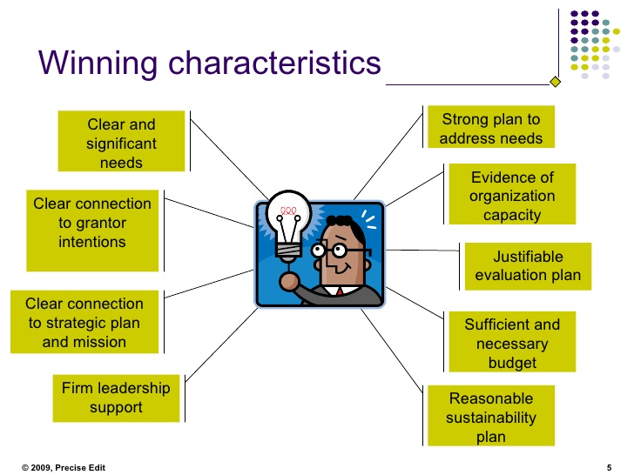

Slide 17
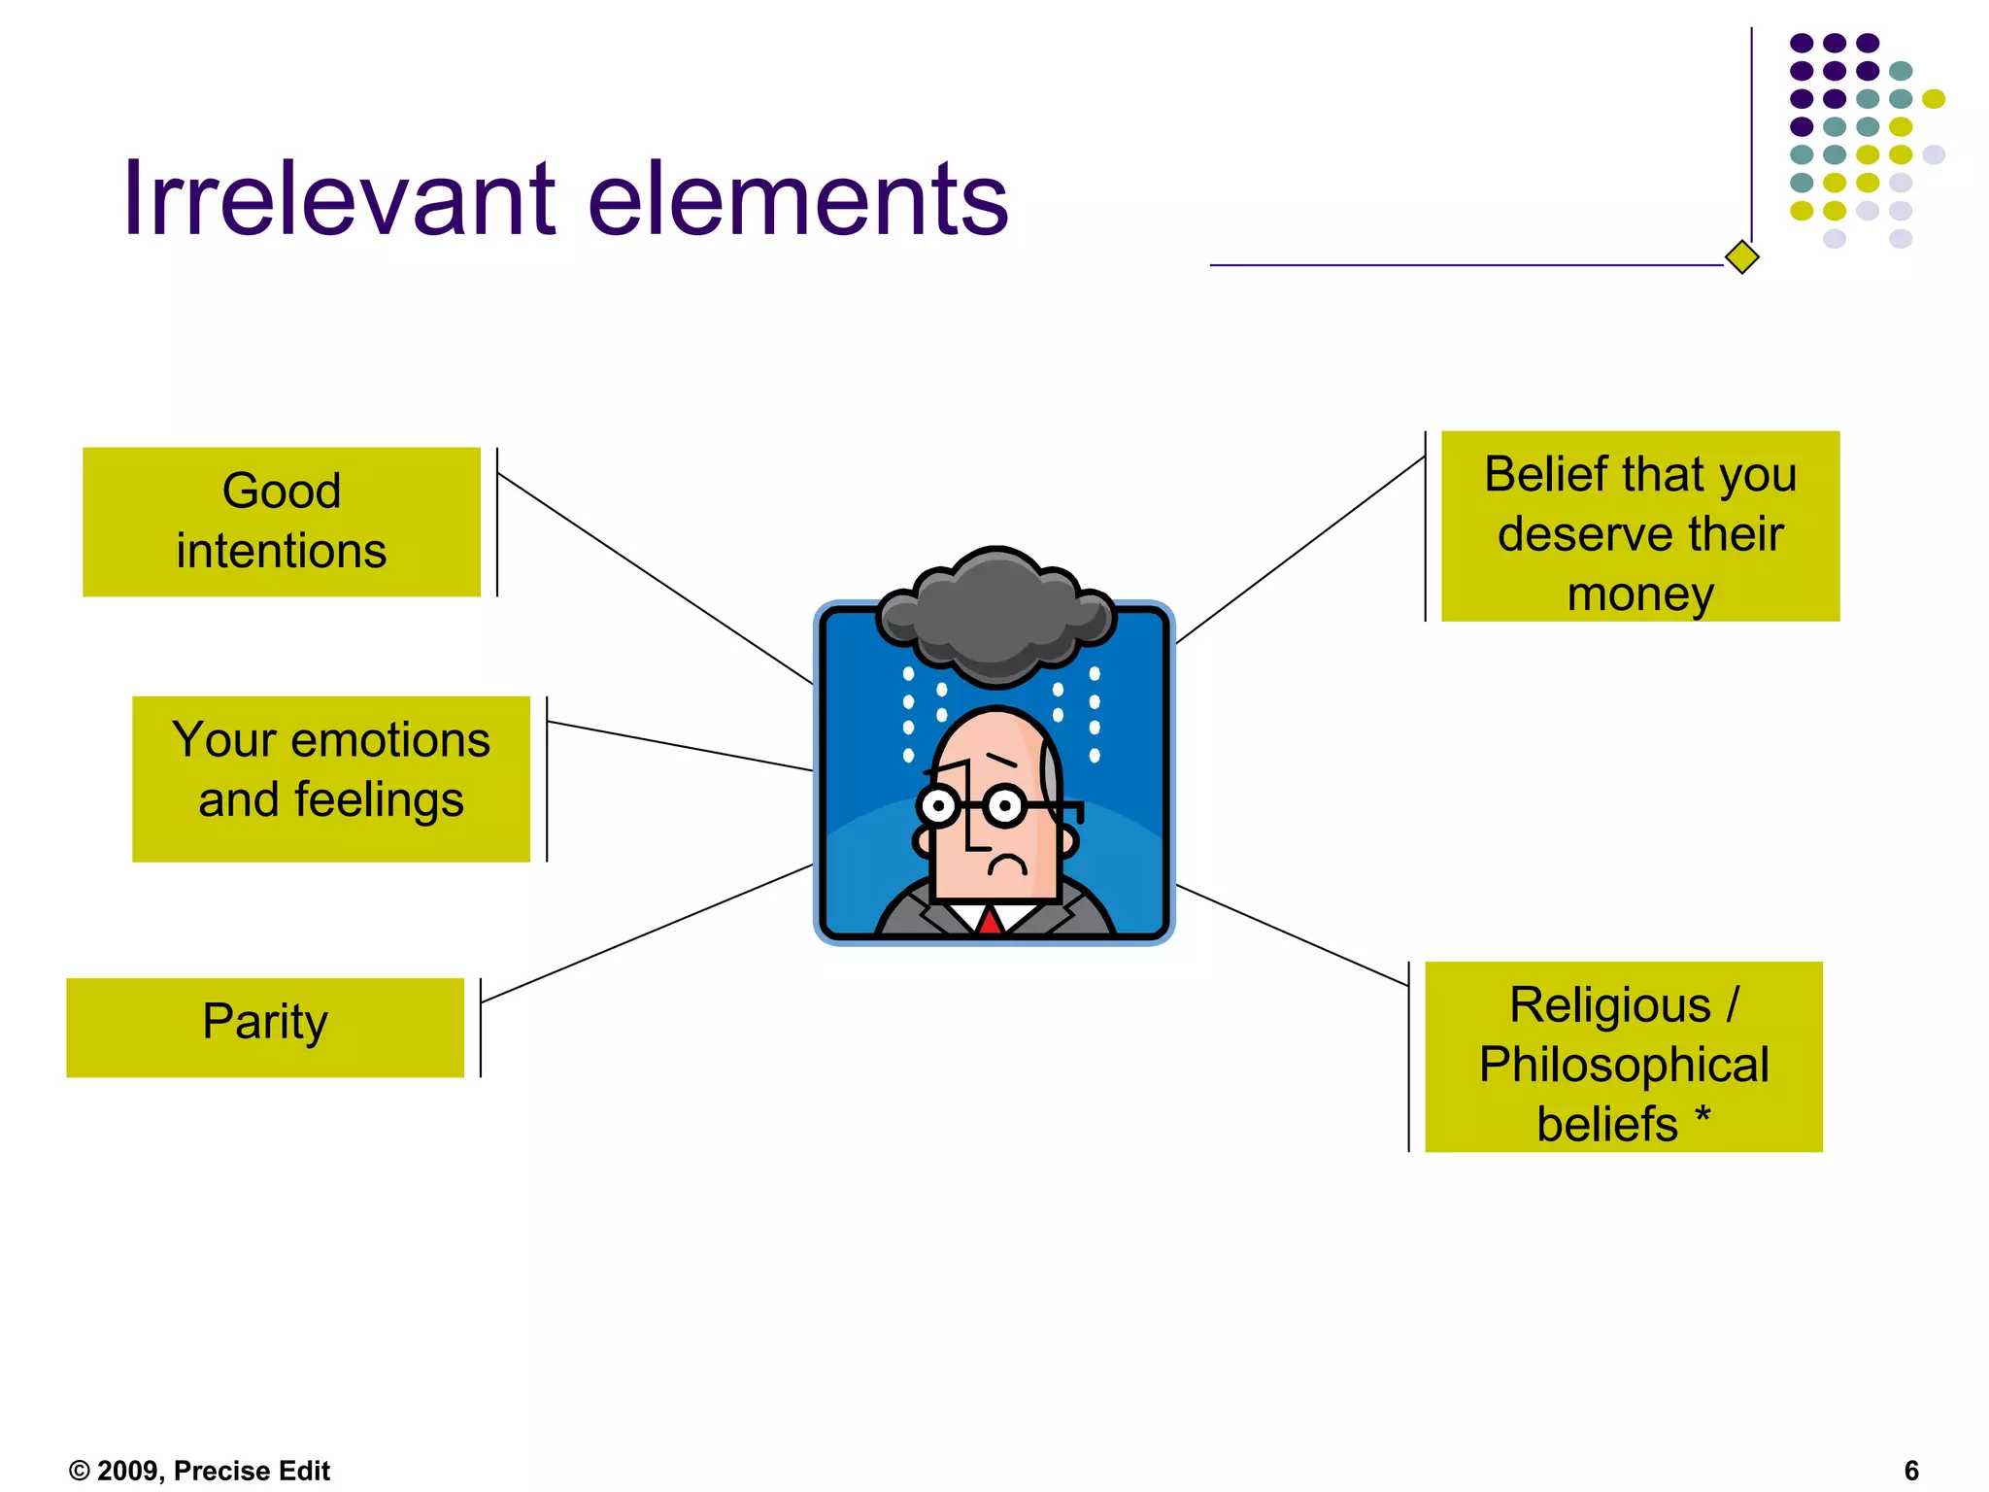
5 Losing characteristics

Slide 18
Example of a winning proposal.
“A thoughtful and honest application always stands out in the crowd!.. It isn’t a hurried and last-minute dash, to meet our deadlines with something dreamed up overnight. It is a serious and sincere attempt by your organisation to use its experience and skill to make a positive difference where it is needed”. Children in Need Grant

Slide 19
How Applications are Assessed.
Reviewed by experts in the area.
Assessed against criteria scoring matrix.
  Suitability.
  Circumstances.
  Purpose.
  Impact.
  Innovation.
  VFM (Value for money).
Look for feedback if unsuccessful.
Real work begins when the grant is awarded.

Slide 20
What Grant Organisation want.
They want you to secure the Grant.
Why you need the money and can be trusted to spend it.
Understand your strengths.
To see a Change they can Believe in! Outcomes,

Slide 21
Tactics: Make a case with your application.
State the need and use compelling Imagery.
How do you know the need exists. Provide research.
How does this fit with other work in your area?
State what company would look like if the need was met.
Invite donor to visit your facility.
State how Outcome will be tracked (not difficult).
Identify cause and show a cause and effect example.

Slide 22
Guide to write an outcome report.
How many people benefited directly or indirectly from this grant.
What is different in people’s lives as a result.
Provide a breakdown of all the costs involved.
What were the highlights of the project.
What were the key lessons learned.
Provide photos, videos, testimonials.

Slide 23
Reporting to a State body.
Outcome Reports required.
Part of grant may be withheld until project completed.
Show logo of state body in publications.
Evaluations and some audits conducted on an annual basis.
Your co-operation is requested, if you are selected for a visit.

Slide 24
Language style.
Short sentences in confident language.
Avoid jargon, “everybody knows”
Be clear and logical.
Write for reader–
Write in active voice.
Be realistic and truthful.
Use meaningful headings and bullet points.

Slide 25
Why Grant Applications fail.
All the information required not provided.
Did not provide purpose for grant.
Proper Budgets not provided and Asking too much.
Applicant not eligible.
Project poorly planned and Criteria not met.
Misses the deadline.
Form incomplete or illegible.
Supporting documents inaccurate, out-of-date, No evaluation completed.
Did not have capacity to deliver project.
.

Slide 26

pppPP

Slide 27
Finding a Funder.
State Grants.
A Funding programme is time specific.
Short notice, Watch for Adverts.
Scored by a panel.
May require matching fund % or exit strategy.
Foundations.
Broad areas of interest.
Decisions made by Board.
Set time lines for applications.
Subscribe to get notification of grants.

Slide 28
How to be successful in Fundraising.
Seek funding from Foundations or Companies.
Show Trust, Transparency & Accountability.
Have robust financial & management systems.
Have a competent Board and good Governance.
Be well run with a good public image.
Have good past programme results.
Link achievements to donor’s contribution.

Slide 29
A Fundraising Case for support
A Plan required by donors, to show you are a worthy investment.
It must answer:
What is the problem you are solving –
What specific service do you offer? Why is it important.
Are others doing the same. How are you distinctive?
Outcomes you expect to achieve?
How much will it cost?
Are you competent to carry out the programme?
Who should support you? Why ?

Slide 30
Develop Donor Retention (27% retained)
Thank donors well — and promptly.
Have excellent public image and Community Image.
Have Qualified diverse Board, with Good Governance.
Know why they support you & deliver their expectations.
Show you are a well run organisation.
Invite donors to visit project and engage with you.
Stay connected with donors and show loyalty.
Evidence the impact you have achieved.
Make them feel part of the organisation.
Develop Shared Beliefs on how mission will be achieved .

Slide 31
Why people give.
Altruism.
Self-interest, Egoism.
Atonement.
Reciprocation.
Tax breaks.
Empathy, personal experience.
Sympathy.
Social justice, Religious beliefs.
Want to be recognised and valued.
Know how money is used and difference it makes.

Slide 32
Why people stop giving.
Lack of recognition or thanks.
Do not feel connected to cause.
Effect of scandals.
Aggressive fundraising tactics.
Lack of transparency in Organisation.
Very high overheads.
Downturn in the economy.
Feel organisation is not fulfilling its mission.
Believe support is no longer needed.
Move to more compelling causes.
Organisation has not kept in touch.

Slide 33
What if grant is not awarded.
Talk to grantor.
Ask lots of questions.
Get feedback on why grant not awarded.
Recraft and resubmit ( if possible).
Learn from it.
Aim for continuous improvement.

Slide 34
Final Check list.
Ensure you meet the criteria.
Answer all Questions.
Provide costs that add up.
State why you are best to deliver project.
Evidence your community need with research.
State outcomes and how they will be tracked.
Meet deadline..
Proofread for errors and word count.
Evidence your Experience, Ability & Competence.
Complete an input sheet for Online applications.
Tips from a Grant assessor
.

Slide 35
Text to Donate.
A quick easy way to donate.
Appeals to young people..
Done immediately on impulse from media.
Method gave 40% increase in fundraising.
Text promotes your cause on social media.
Easy to set up. Link to a provider.
Billed through mobile phone or Debit card.
Secure for donor.
Cost free to organisation.
Digital fundraising- similar done on company website.

Slide 36
Errors found in applications.
Very common mistakes.
Did not read the criteria.
Cannot clearly explain project activity.
Timing not aligned with grant.
Costs don’t add up.
Other mistakes.
Blank answers to questions.
Category not ticked.
Difficult to read due to grammar errors.
Request amount outside funding.
Missed deadline.
CHECK YOUR APPLICATION!!

Slide 37
Fundraising Regulations.
Read the guidelines on fundraising by Charities regulator.
Specific definition of non-cash collections.
Permits required from police for collections.
Provide Identification including the charity registration number If you have one.
Sealed Buckets for Cash collections.
Download.
Guidelines for Charitable Organisations on Fundraising
from the Public.
www.charitiesregulatoryauthority.ie

Slide 38
Useful contacts
https://www.communityfoundation.ie/grants/grants-support-hub ( A video guide)
www.udaras.ie
www.charitiesregulatoryauthority.ie
grantsinfo@irlfunds.org
www.communityfoundation.ie
Rethink Ireland Email. hello@rethinkireland.ie
Department of Rural and Community Development.
10-11 South Leinster Street, Dublin 2,
Solas
Website:www.gov.ie/drcd/ Email:info@drcd.gov.ie
Phone number:01 773 6860

Slide 39
3 Types of Not for Profit Organisations
Those that wonder what is happening.
Those that watch what is happening.
Those that make things happen .
Which is yours?

Slide 40
Questions
Evelyn Fitzpatrick Consulting
Email: evelyn.fitzpatrick@gmail.com
https://www.carmichaelireland.ie/courses/

