Slide 1
Media Promotion, Social Media & Content Creation - PPN Summer School 2026
DCU Digital Communications
Jane Last
Head of Digital Communications, DCU
Ger Shiels
Social Media & Online Engagement Editor,
DCU

Slide 2
Overview
Intro to DCU’s Social Media in 2026
Content Creation
Event Promotion
Questions
Notes:
Brief overview of DCU’s social media in 2026 and more of a focus on content creation and event promotion

Slide 3
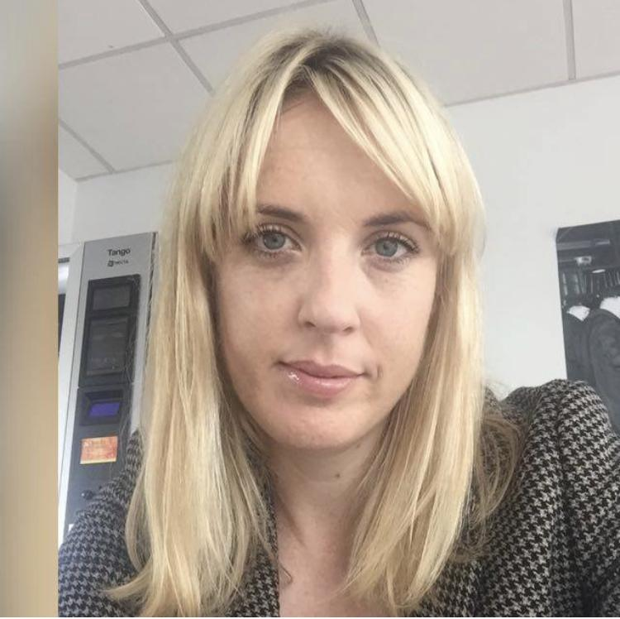
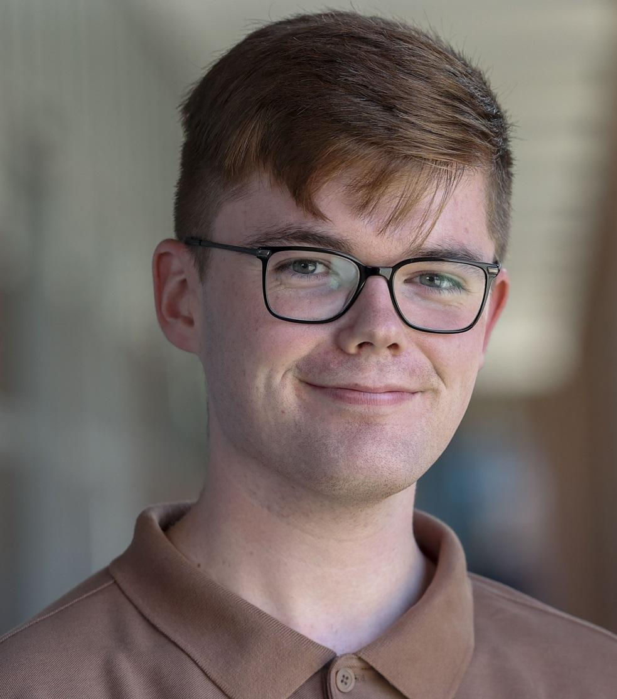
Intro to DCU’s Social Media in 2026
Jane Last
Head of Digital Communications, DCU
Digital Communications
  Social Media Channels
  Social Media support
  Provide analytics
  Provide support for ‘live’/virtual events
Ger Shiels
Social Media & Online Engagement Editor,
DCU

Slide 4




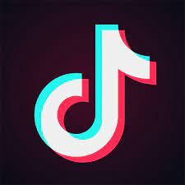

DCU’s Social Media Channels
LinkedIn – 164,000 followers
Facebook – 74,000 followers
Bluesky - 1,200 followers
Threads - 4,400 followers
Instagram – 54,700 followers
TikTok – 10,100 followers/236.9k likes
Notes:
DCU's departure from X (Twitter) and the addition of Bluesky and Threads
Recent decision to pause activity on X (Twitter), noting no immediate impact so far but no replacement

Slide 5
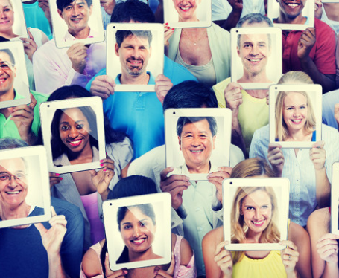
Knowing your Audience on Social Media
Different voices for different platforms
  Facebook – Our most engaged audience on Facebook is women aged between 35 and 55 - Older/Community audience
  LinkedIn - 4k DCU employees and 94,000 alumni - Corporate
  Instagram – Almost 50% of audience is aged between 18-24. 60% women, 40% men and most active between 3pm and 9pm - Younger but growing demographic
  TikTok – 70pc female – 152.9k video views from September 2025 to November 2025 - Younger but growing demographic
  Focus on one platform effectively rather than maintaining multiple accounts
Notes:
Emphasise the importance of doing one or two platforms well rather than managing multiple platforms poorly

Slide 6
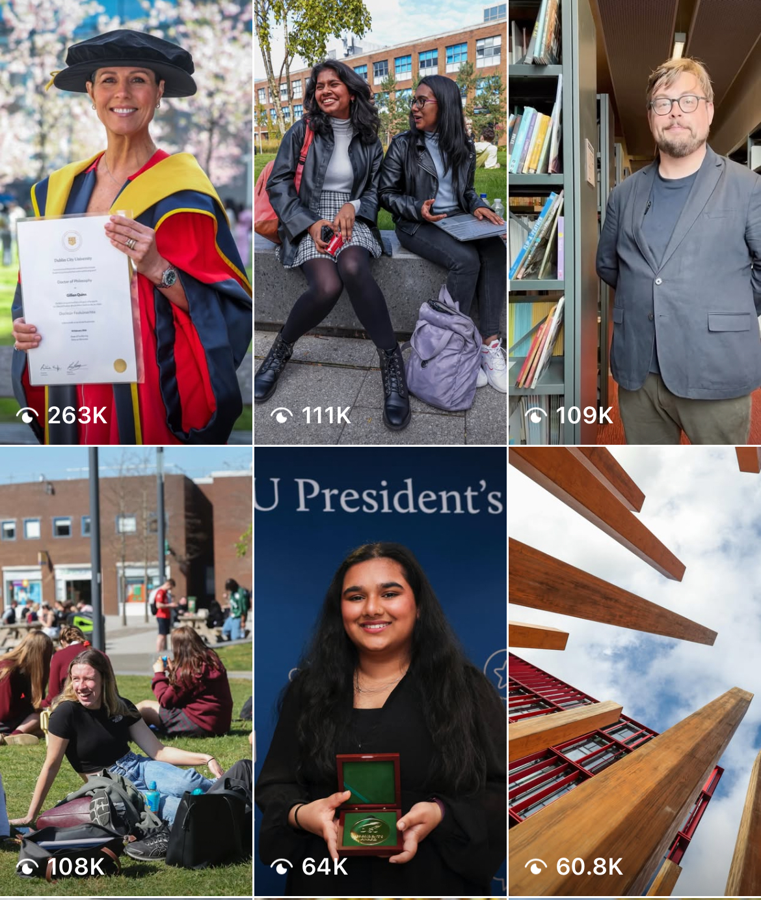
Content Creation - Tips & Tricks
Short-form (30-60-90s) on Instagram and TikTok - Shot on Phone and edited in-app or CapCut etc
CapCut - Video editing tool - Evolved from a free platform to a paid subscription
Subtitle-heavy for accessibility purposes, audio has to be high quality and a steady hand is key
Person needs to be comfortable in front of a camera

Slide 7
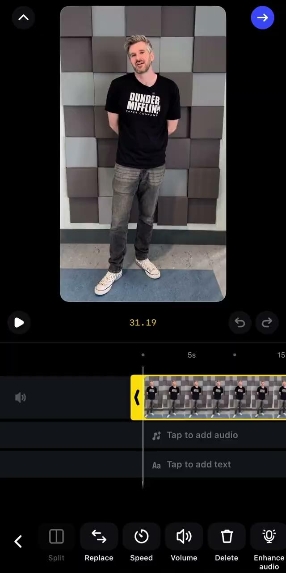
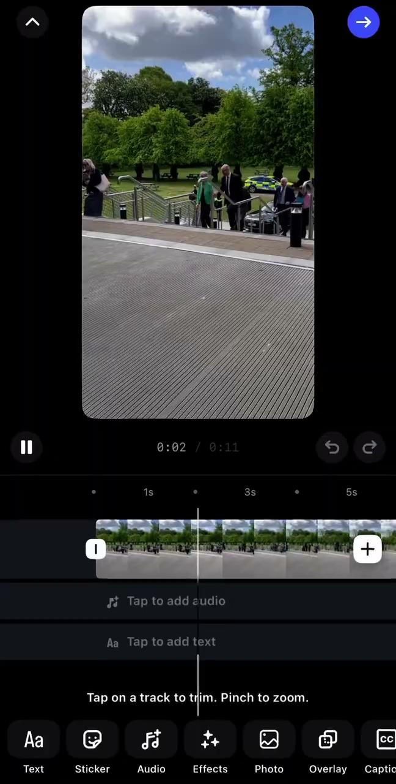
Content Creation - Reels
Instagram’s built-in Reels editor offers basic tools for short-form content
Tools include trimming, captions, audio, speed, overlay, reorder, and much more!
Video content that is authentic and ‘perfectly imperfect’ is what users are looking for on Instagram and TikTok
Resharing reels to your Instagram Story is a great way to build views which will raise awareness about an event etc

Slide 8

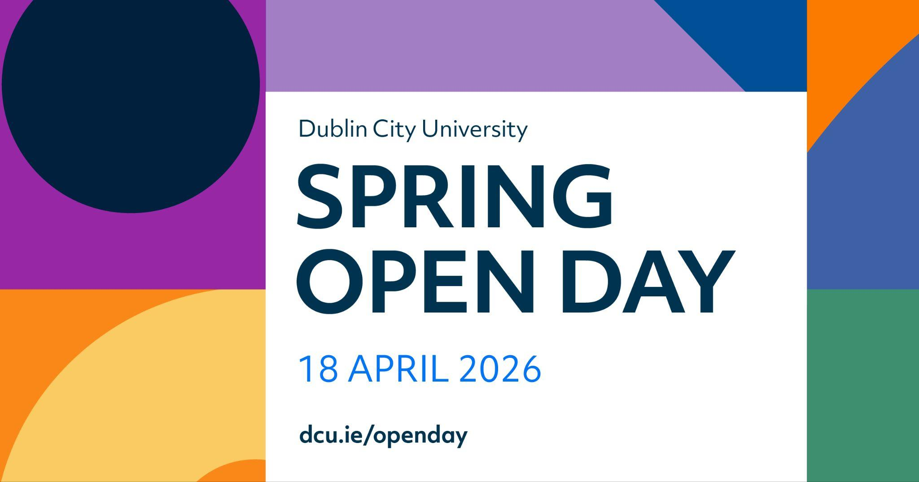
Event Promotion
Key events in the academic calendar - Orientation, Graduations, Open Days
Promote and amplify DCU related events - Student Support & Development / Students’ Union / Office of Student Life / Faculties
Provide live coverage or behind the scenes snippets - This works best on Instagram Reels/Stories - Can be repurposed for promotion
Important to include: Opening line, Key information, Call to action, Infographic/Image/Video
Student Recruitment activity promoted through organic and paid social

Slide 9
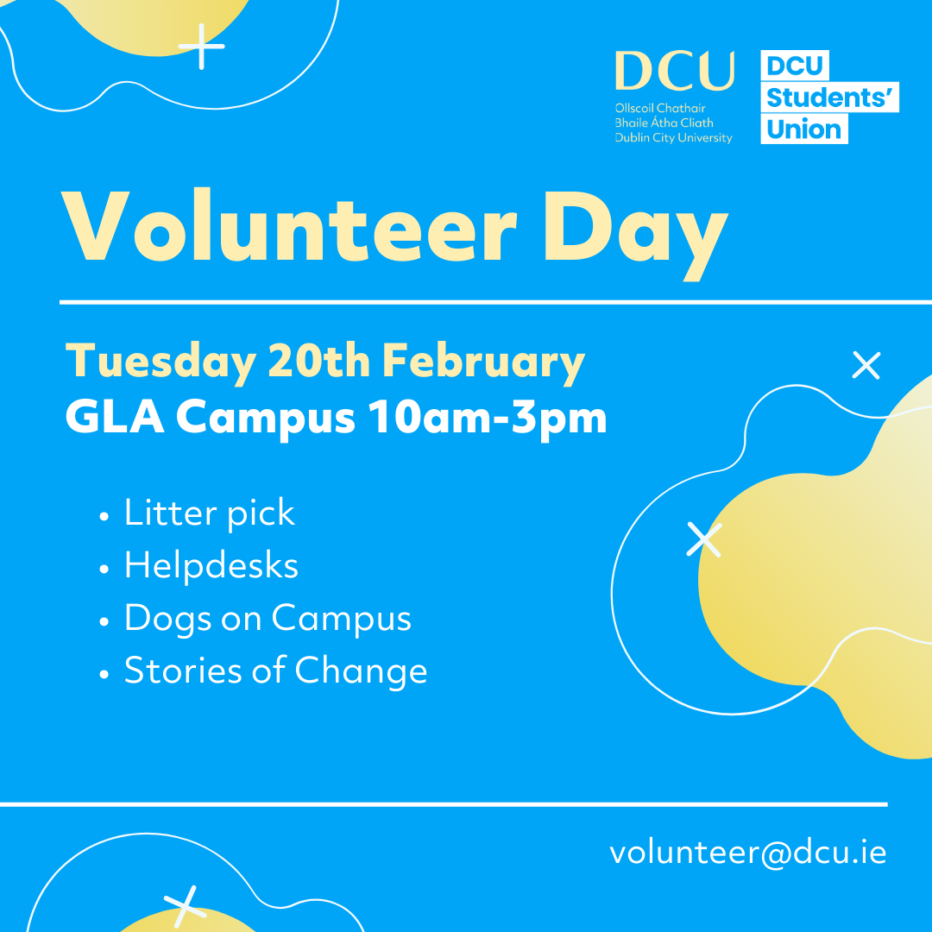
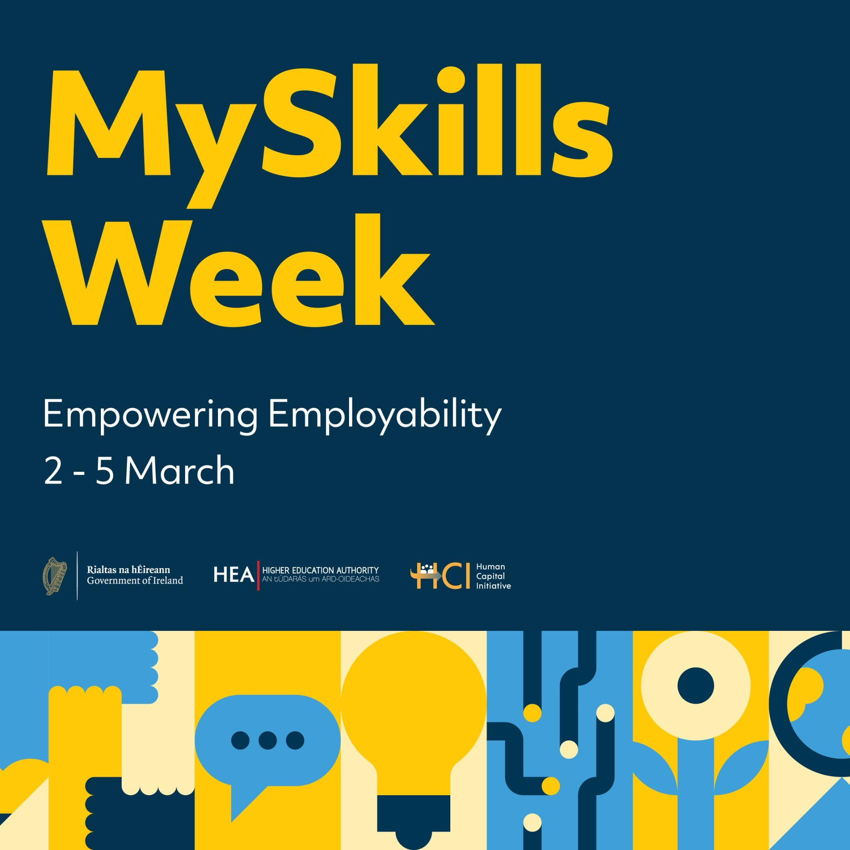
Event Promotion
Paid social media advertising allows you to target a specific demographic moving away from traditional methods of advertising
Static graphics/Canva can be used as alternatives for video content
AI platforms like ChatGPT and Claude can help improve written content - Human oversight and review before publishing
Tag organisations and ask colleagues/peers to reshare posts - Helps with reach and impact
Social media noise - Letting it die down
Notes:
Explain targeted advertising capabilities and practical payment considerations (credit/debit card requirements, no invoice system)
Acknowledge resource limitations around video content
Emphasise need for human oversight and review before publishing AI-generated content
Explain when it's acceptable to do nothing and let social media noise die down

Slide 10
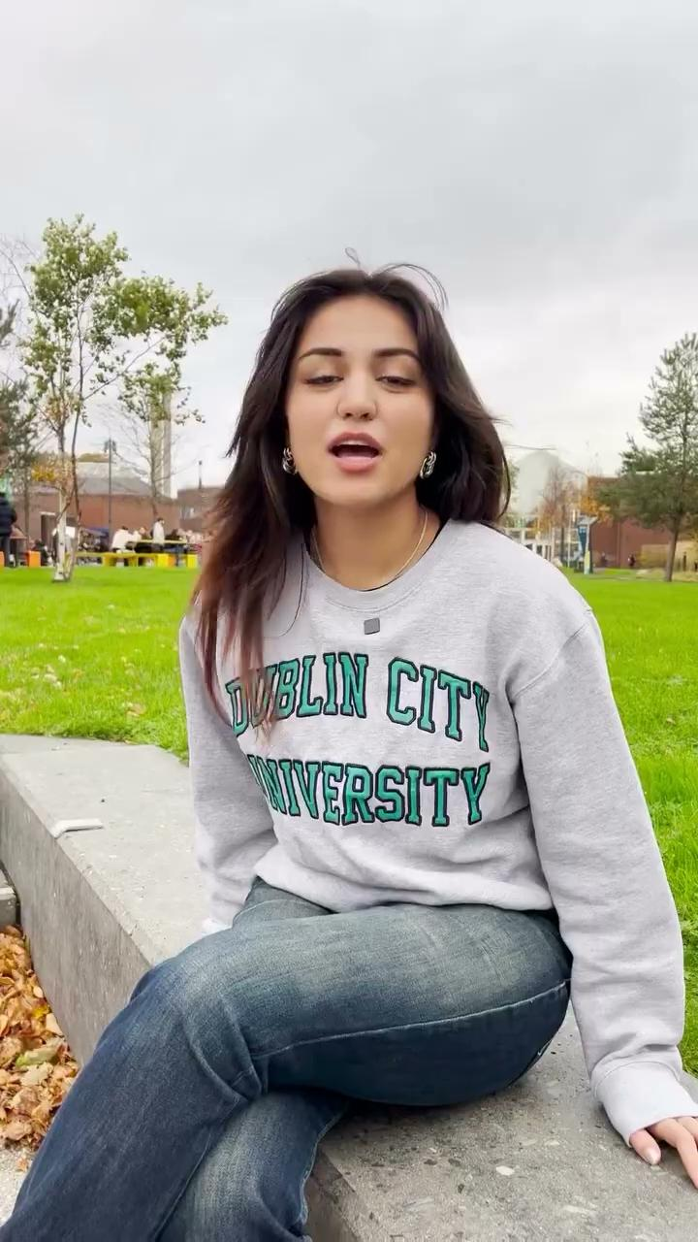
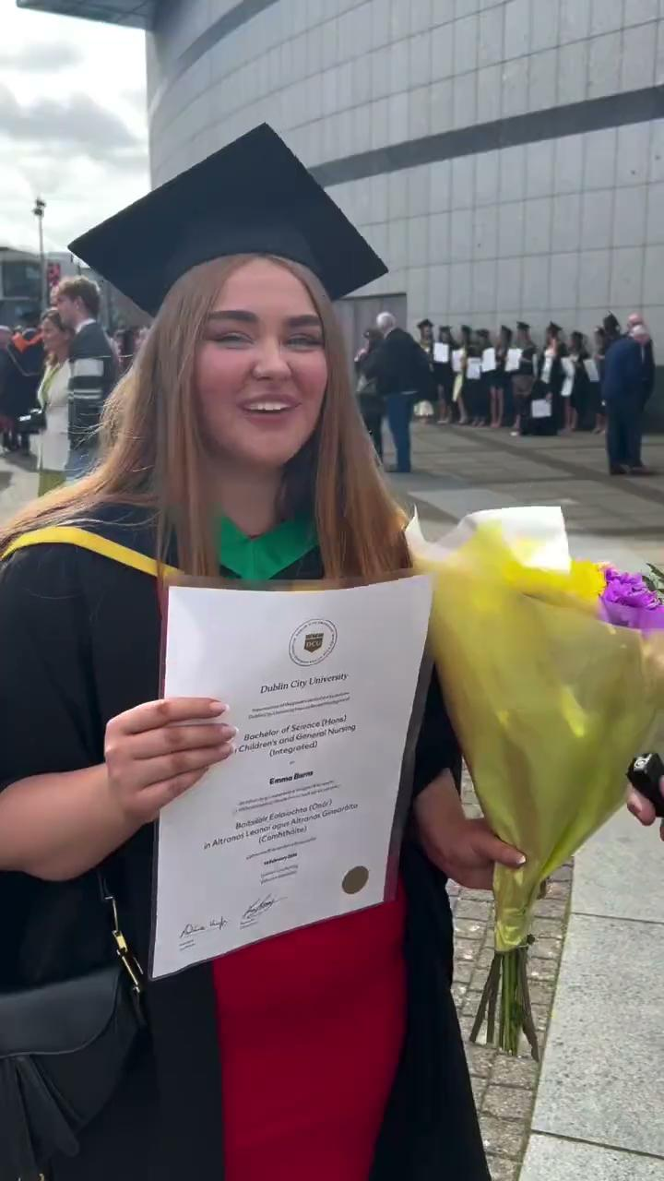
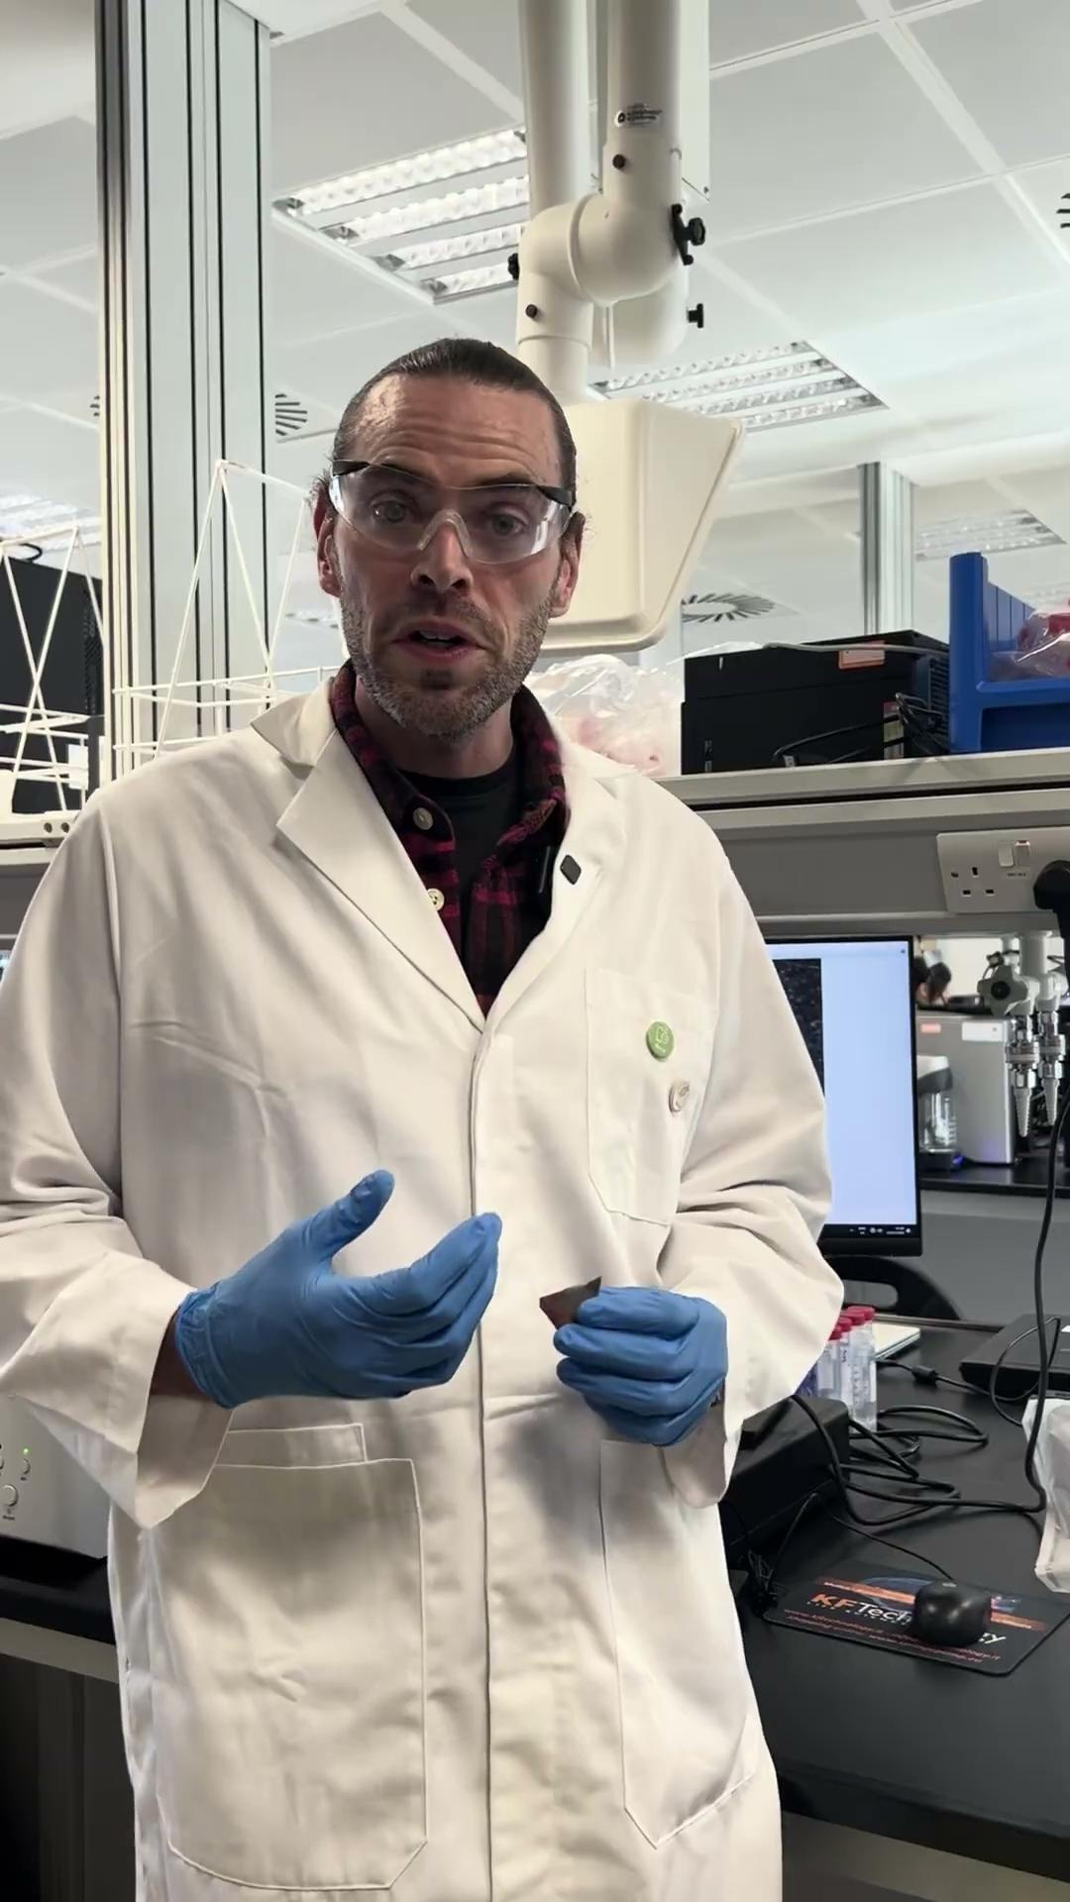
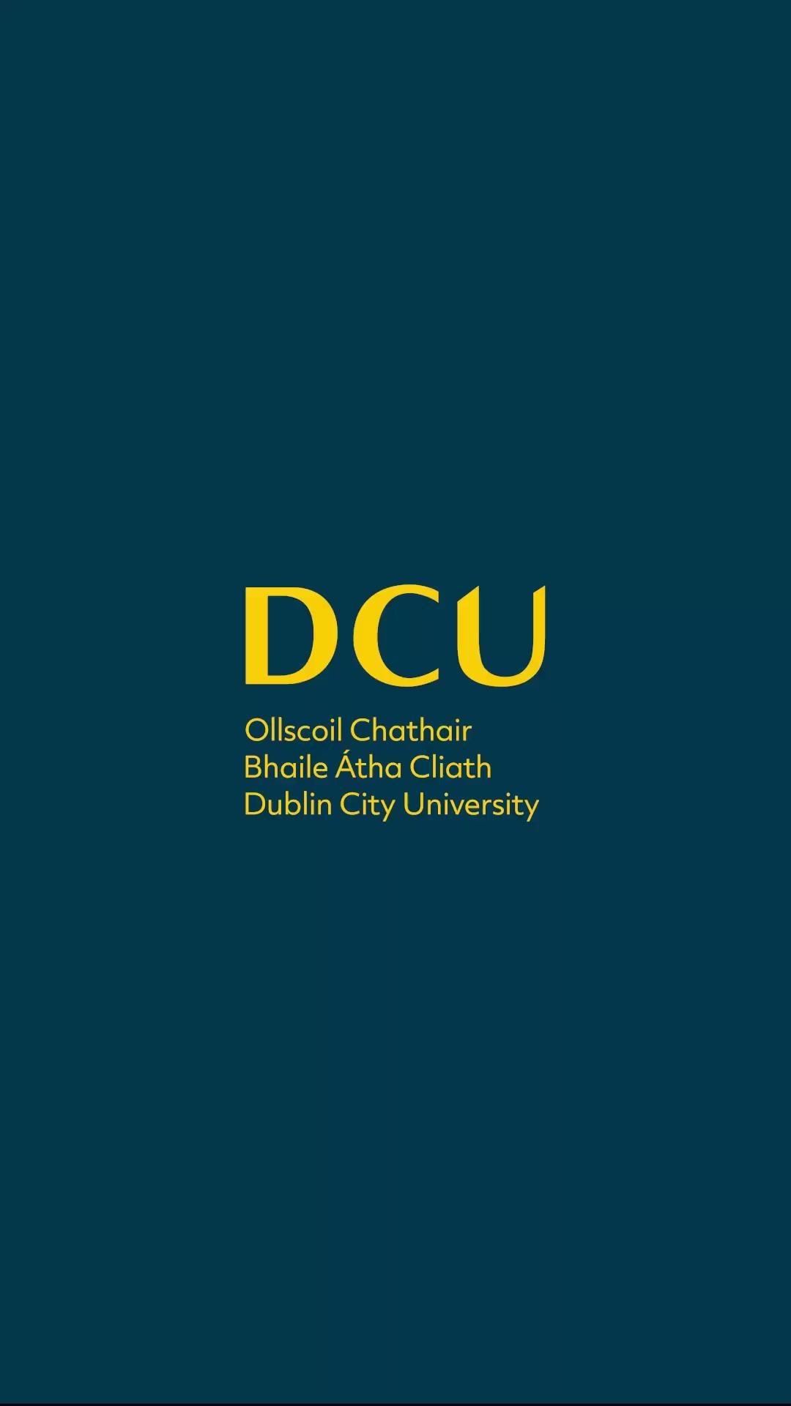
Content Creation/Event Promotion - Organic DCU Examples

Slide 11
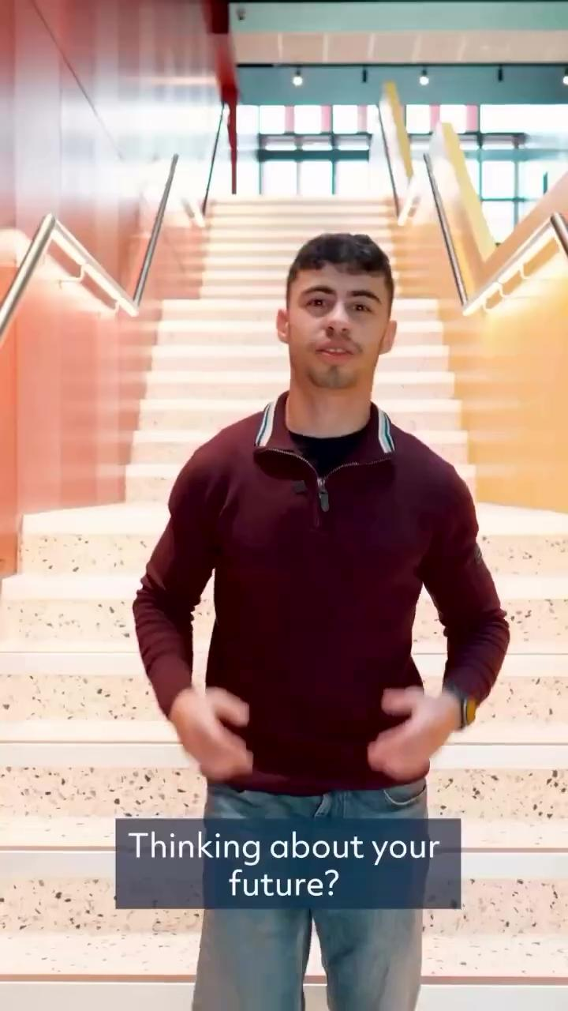
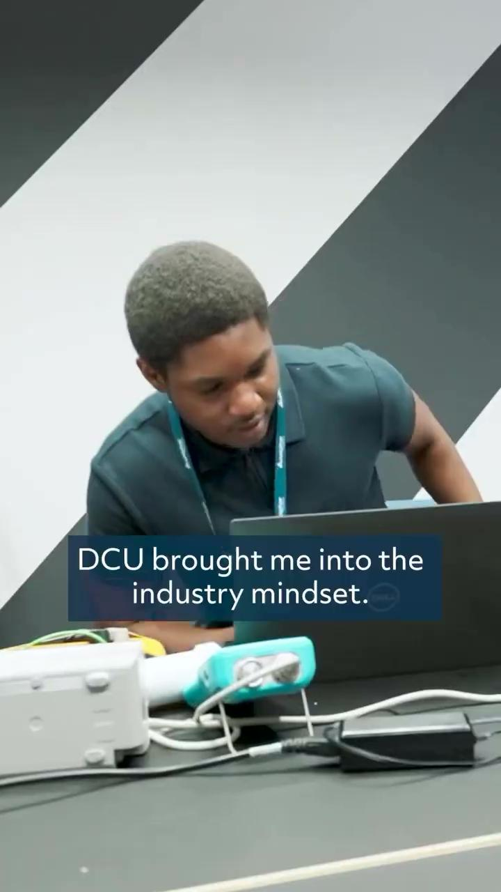
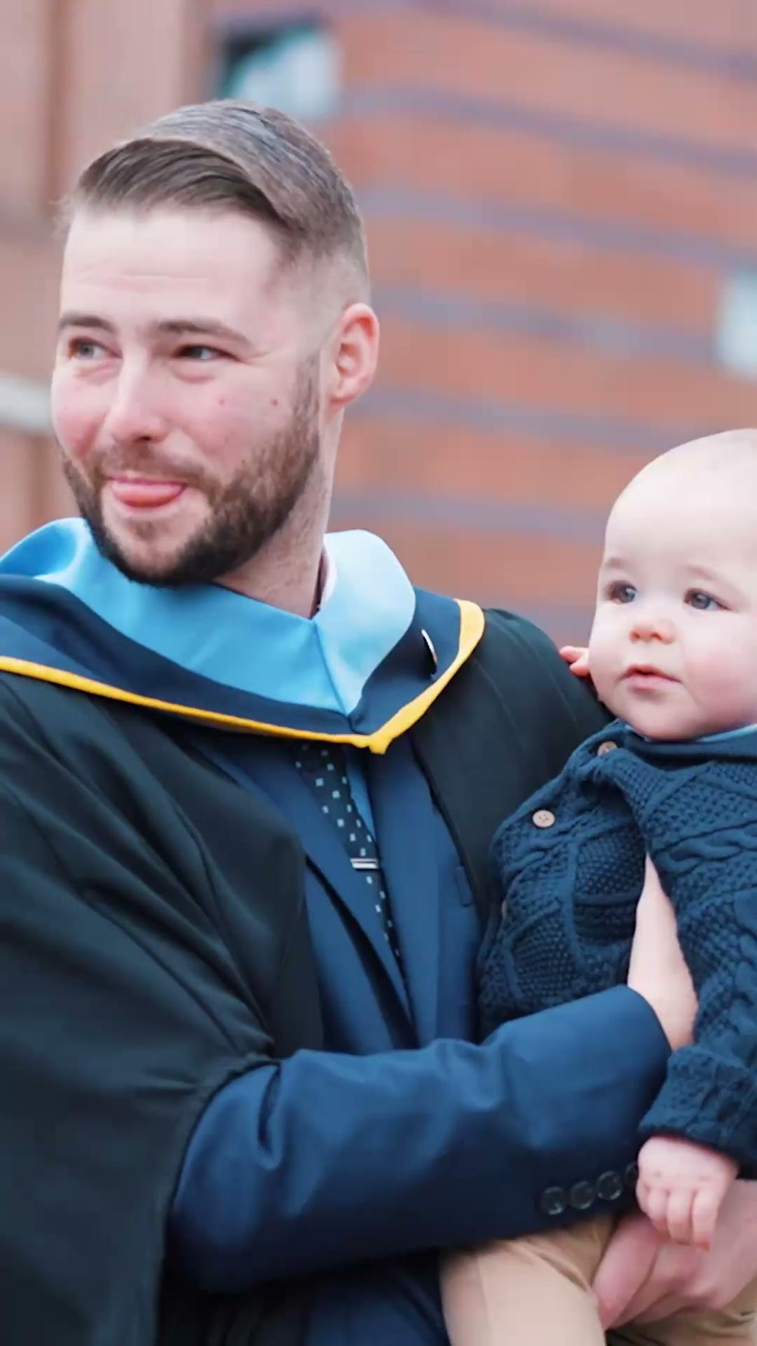
Content Creation/Event Promotion - Paid DCU Examples

Slide 12
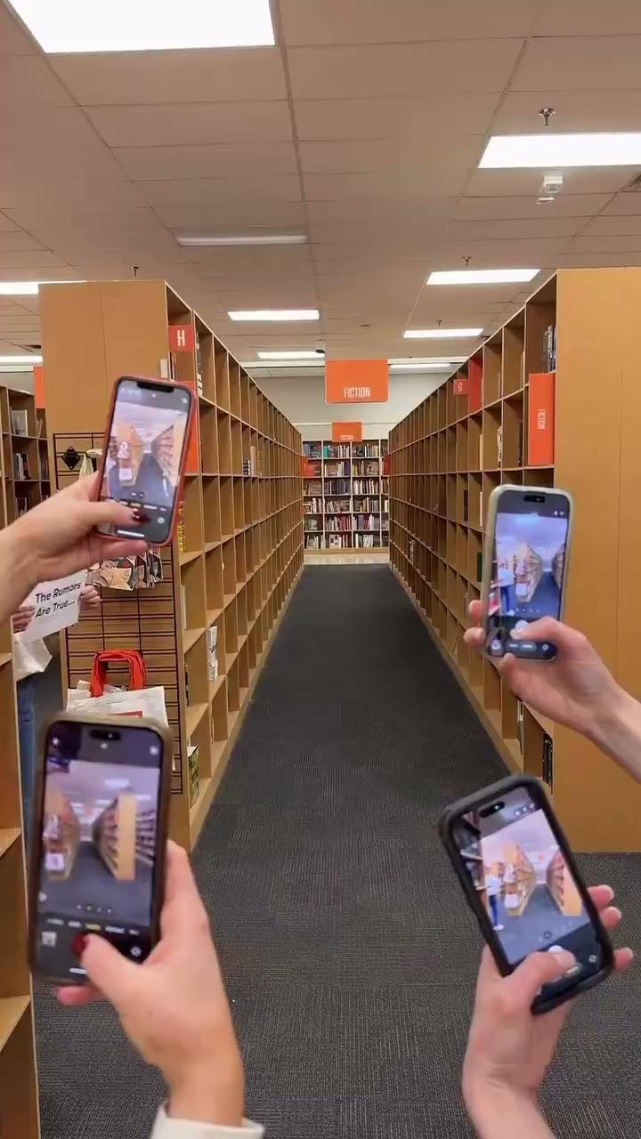
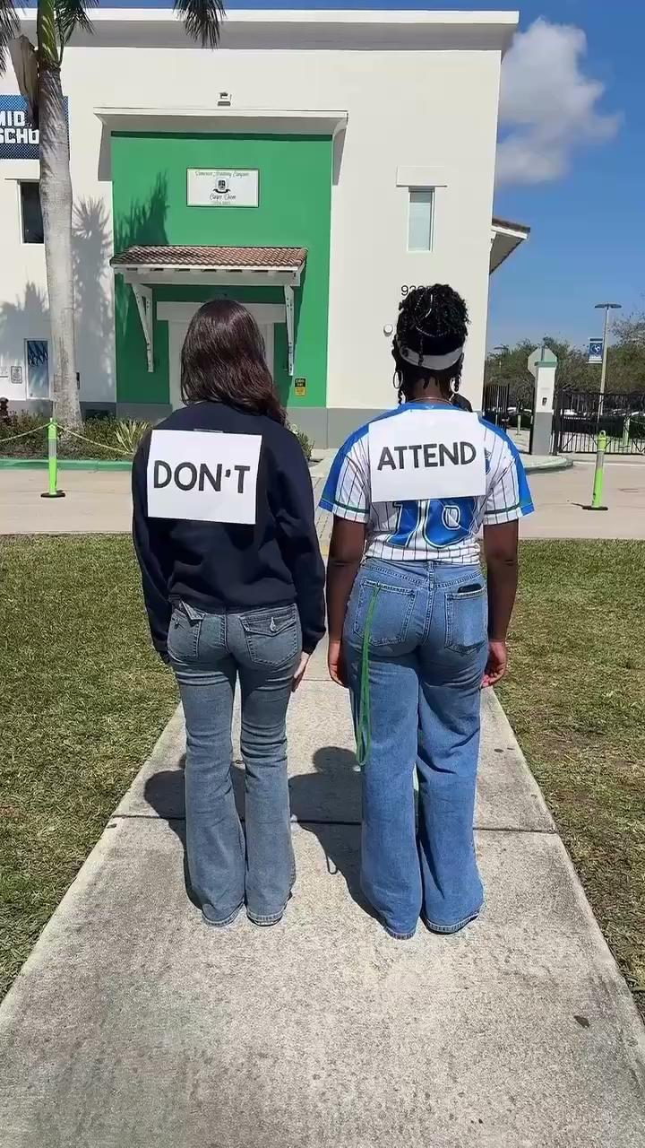
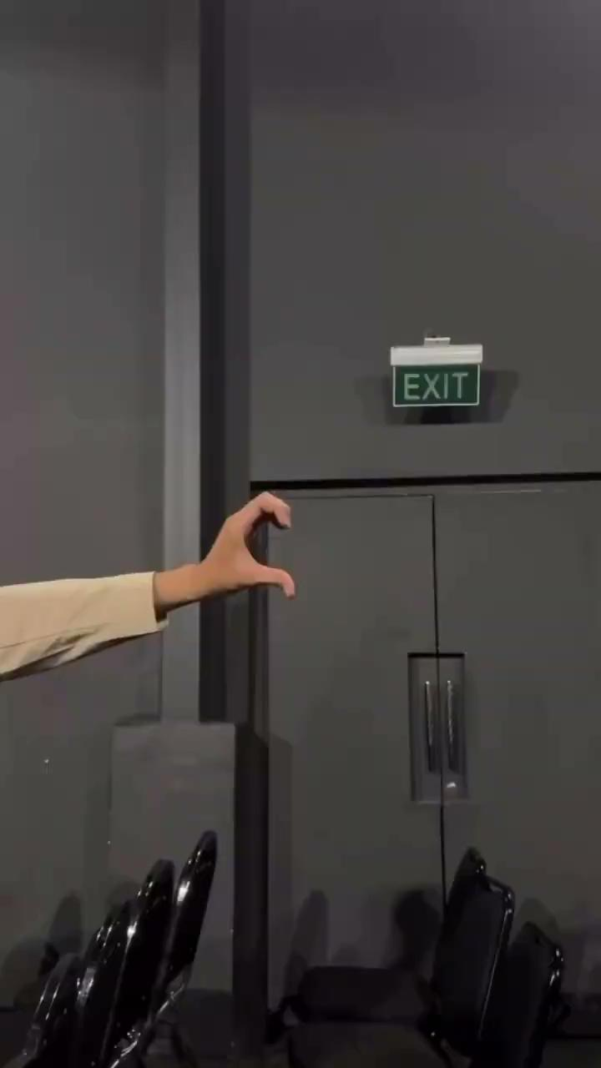
Content Creation/Event Promotion - External Examples

Slide 13
Any questions?

