Slide 1
Mis/Disinformation, Young People and Ireland’s Community & Voluntary Sector
Shane Murphy PhD — DCU FuJo

Slide 2
This talk and the research
This session is about how mis/disinformation impacts two distinct areas:
Study 1 — Young People
In partnership with the National Youth Council of Ireland.
Six focus groups (April–July 2025)
32 participants aged 18–24 from across Ireland
Members of migrant, LGBTQ+ and Traveller communities all represented
Study 2 — Community & Voluntary Sector
In partnership with The Wheel.
200 survey responses + 20 follow-up interviews
November 2025 – January 2026

Slide 3
Survey headlines
Impacts of Mis/Disinformation on Ireland’s Community and Voluntary Sector
What organisations are seeing
85% encounter anti-NGO narratives online
“A waste of taxpayer money” (67%)
“Corrupt” (56%)
“Unaccountable” (55%)
How it’s impacting them
85% say it’s impacting their objectives
Damaging credibility (42%)
Direct targeting and harassment (26%)
Changed communications strategies (55%)

Slide 4
Three ways it’s impacting the sector
1. Societal Distrust
  Delegitimisation of the sector and its expertise.
2. Direct Targeting
  Harassment of staff, volunteers and services.
3. Internal Disruption
  False narratives circulating inside organisations.

Slide 5
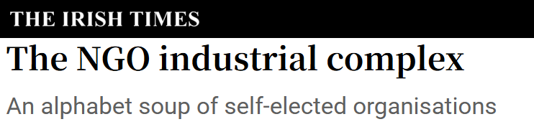
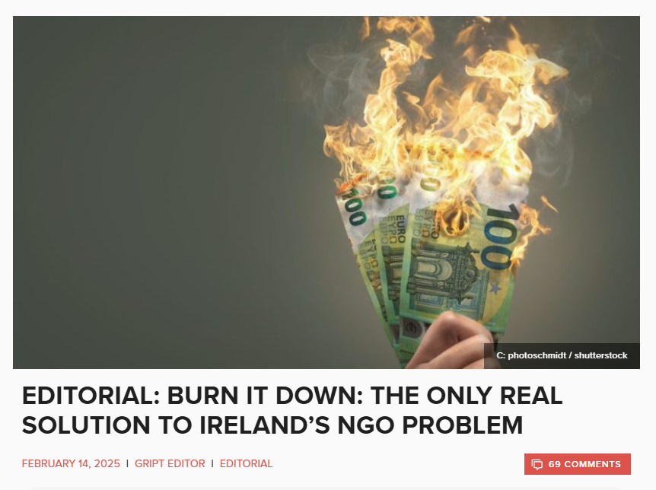
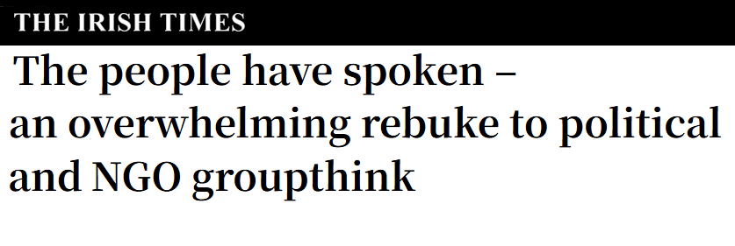
Societal distrust
Frontline expertise treated as opinion. Advocacy dismissed as political. Organisations framed as ideological or extreme.
Policymakers, media and partners less willing to engage.
Organisations soften their language. Stigma drives service users away.
“You’re radical just by virtue of working in this sector.”

Slide 6


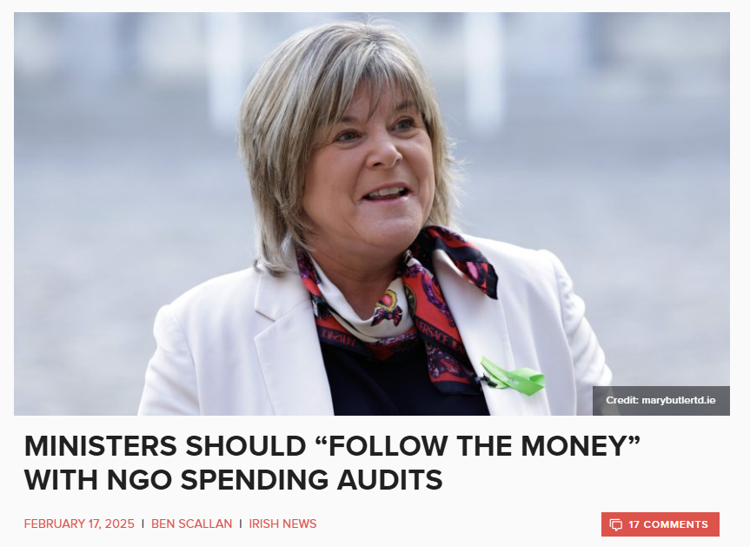
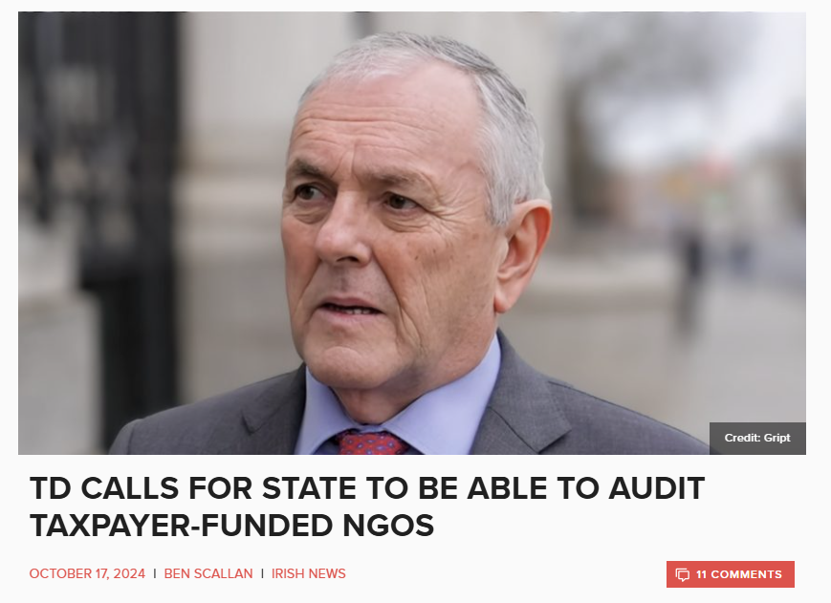
Funding and bureaucratic pressure
Funding narratives are a common attack vector: “wasteful,” “overpaid,” “bloated,” “unaccountable.”
Figures stripped of context. Spending framed as “taxpayers’ money.”
Compliance burden grows. Some organisations avoid funding opportunities altogether.
Resources diverted from frontline work into proving legitimacy.
“It’s just looking for any cudgel to use against the sector, especially organisations helping ‘the wrong’ people.”

Slide 7
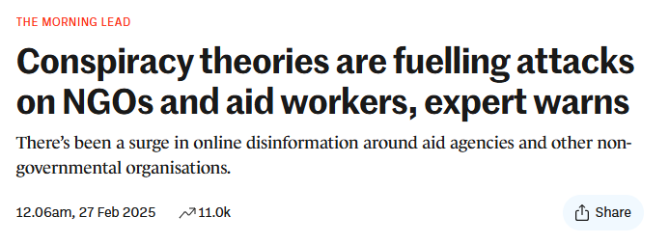
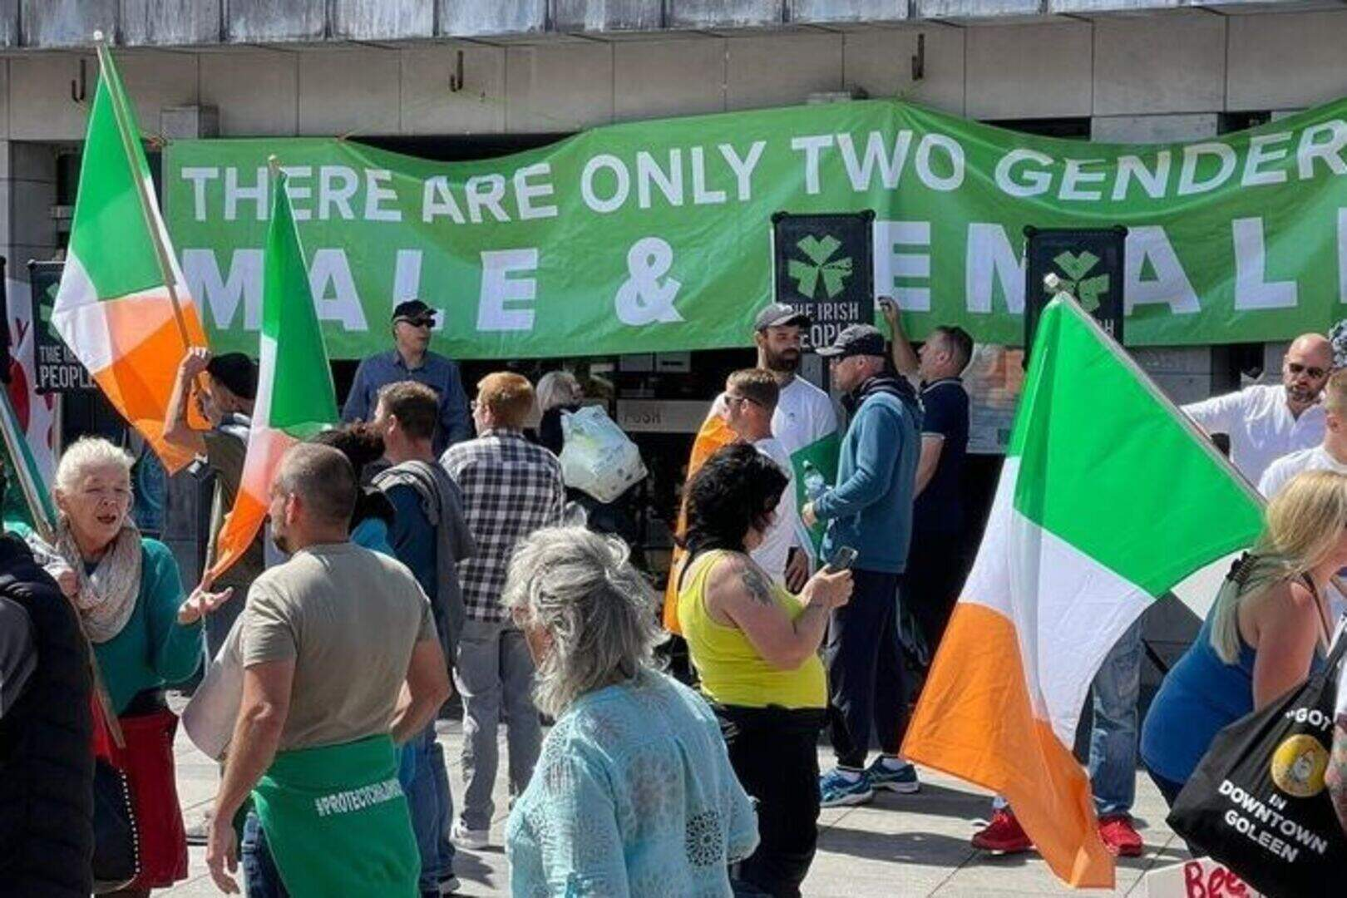
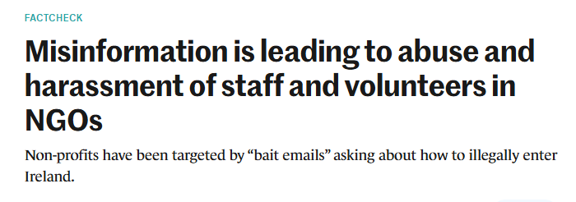
Direct targeting and staff safety
Routine harassment of staff and volunteers: online abuse, filming, doxxing, coordinated complaints.
Especially acute in migration and LGBTQ+ work. Often racist, misogynistic, or focused on appearance.
Organisations leave social media, restrict event promotion, add new security measures.
Staff wellbeing and retention affected. Services harder to access as openness creates risk.
“They love being able to put a face to it.”

Slide 8
“Baiting” emails
Bait designed to extract a controversial response.
Posing as displaced people asking how to enter Ireland illegally; or as under-15s asking for hormones or medical access.
Tell-tale signs: stilted tone (possibly AI-generated), atypical senders, pointedly direct messages.
Safeguarding language triggers Tusla and Garda referrals — every message must be treated as legitimate by default.
“They don’t need to be ‘successful’ to slow you down and waste time and resources.”

Slide 9
Internal disruption
Misinformation circulates inside the sector — repeated by staff, volunteers, board members, councillors and local partners.
Anti-migrant narratives especially disruptive.
Internal conflict strains trust; impacts recruitment and retention.
Local collaboration weakens when boards or councillors accept false narratives.
“People who are supposed to be supporting the work become a barrier.”

Slide 10
Summary
Distrust, harassment and internal disruption compound.
  Eroding both the sector’s capacity and the public infrastructure it sustains.
Service users absorb the cost.
  When organisations are forced to retreat or self-censor, the people who rely on their services are impacted first.
The sector cannot defend itself alone.
  There are limits to how much the community and voluntary sector can achieve without support from policymakers, platforms, regulators, media and funders — and they are already stretched incredibly thin.

Slide 11
What young people are actually seeing
Participants were comfortable identifying disinformation relating to anti-migrant and anti-trans themes, and shared numerous examples of harmful narratives they had seen.
But participants more commonly encountered false information in less overtly political forms — usually through “self-help” content designed to educate audiences on fitness, nutrition, beauty, finances, mental health.
Three factors made this content hard to identify:
  Incomplete information or lack of context
  Difficulty distinguishing between good and false information
  Positive Framing

Slide 12
Where it comes from
Discussions of mis/disinformation often focus on well-known individuals and big accounts. However, young people more commonly encountered false information via:
Small accounts
  “Not Conor McGregor or Andrew Tate — Conor McGregor and Andrew Tate wannabes”
Local and private groups
  WhatsApp, Facebook, Discord, etc.
Comment sections, livestreams, and ephemeral content (e.g. stories)
  As opposed to discrete posts

Slide 13
And from people they know
Exposure to false information via real-life interactions with family members was incredibly prevalent throughout the focus groups.
Particularly impactful, as it cannot be ignored as easily as disinformation encountered online.
Also more difficult to respond to, as it has the potential to damage relationships.

Slide 14
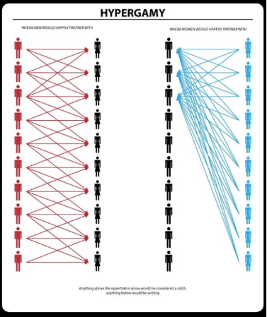
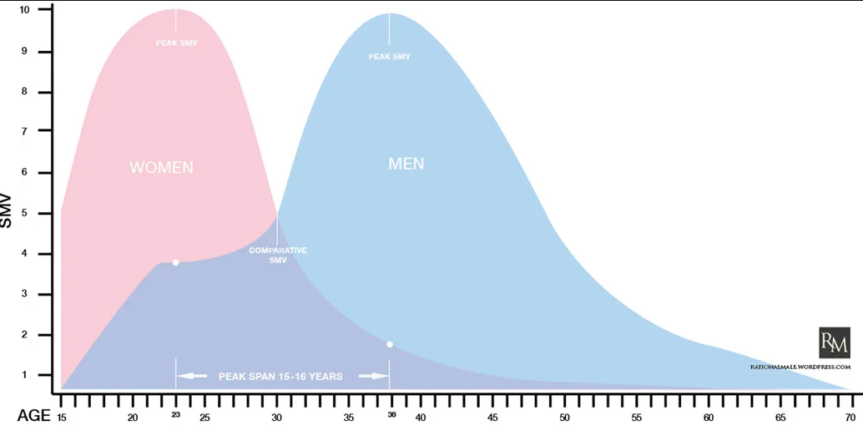
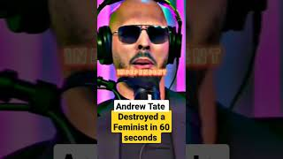
Toxic Online Cultures: The Manosphere
Red Pill “Science”
Distorted gender dynamics framed as “common sense” or “rationality”.
Evolutionary psychology used to justify male dominance and female subservience as “natural”.
Feminism blamed for making women “too selective” and causing male loneliness.
Male Victimhood
Feminists portrayed as irrational; men as rational but disempowered and under-appreciated.
Women blamed for declining birth rates, men’s mental health, the collapse of “traditional values”.
Embedded in non-political online spaces — sports, comedy, lifestyle, science.

Slide 15


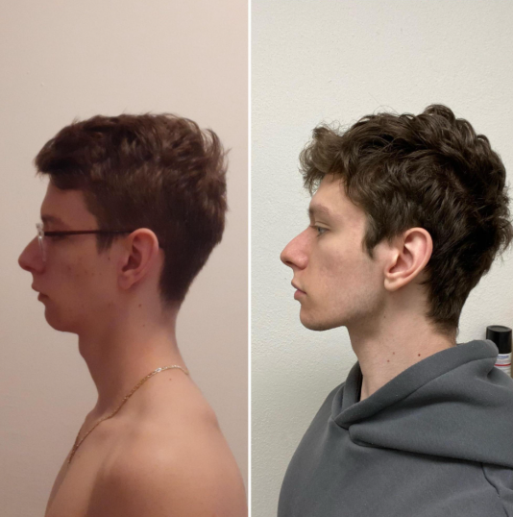

Toxic Online Cultures: Hustle and Looksmaxxing
“Hustle Culture” & Finance Bros
Aspirational “grindset” content promising wealth if you follow certain steps.
“9–5s are slavery”, “How I Turned €200 into a Lambo in 60 Days”.
“Success Influencers” selling expensive courses, often pyramid schemes or crypto scams.
Appearance, Fitness, Looksmaxxing
Obsession with hyper-muscularity and bone structure.
Routines like jaw exercises (mewing), restrictive diets, and cosmetic surgery.
Pseudo-science and unrealistic before/after comparisons drive body dysmorphia.

Slide 16
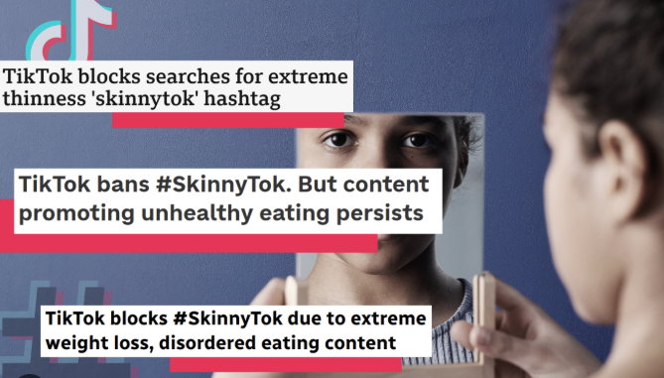

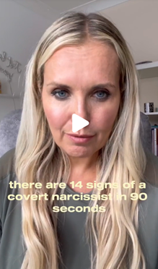
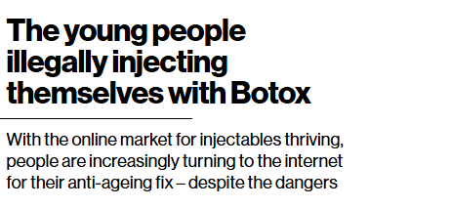
Toxic Online Cultures: Fitness and “Wellness”
Diet Culture & “Wellness”
Extreme thinness, restrictive eating and detox fads disguised as “wellness” or “clean living.”
“What I Eat in a Day” normalizes undereating; unregulated “fat-burning” supplements and dangerous nutrition advice.
Advice on home cosmetic procedures (filler, botox, mole removal).
Mental Health Content
Over-pathologising normal feelings - “trauma healing” tips, attachment style quizzes, boyfriend “red flags”.
Therapy language misused to explain everyday relationships; advice from people lacking professional training.

Slide 17
Summary
While many examples are political, the majority of false information to which young people are exposed falls into the domain of “self-help” content - health, beauty, money, identity, relationships.
It comes from people young people know and trust, not just big online figures (smaller accounts, local groups, real-life).
It largely relies on creating and exploiting insecurities in young people in order to get attention, boost engagement, and generate profit

Slide 18
Conclusion
In both cases, the spread of false information is helped by fostering and then exploiting negative emotions such as anxiety and distrust.
Much of the content is legal, and does not violate platform policies. Those creating the content are incredibly good at “walking the line”
This can make them difficult to address through regulation and platform moderation. These are still important tools for addressing the issue, but not currently equipped to sufficiently respond to this information environment
Because of this, responses which involve promoting critical thinking, digital literacy and media literacy etc. are important. These help people understand how content is designed to work on them emotionally, and build resilience

Slide 19
Thank you
Questions?
Murphy.Shane@mail.dcu.ie

