Slide 2
Workshop Agenda
Welcome and Introductions
Presentation that will focus on:
The benefits of inclusive community engagement in planning and decision-making processes
The principles
How to put those principles into practice, including
stakeholder identification,
identification of barriers,
supports and outreach,
creating an inclusive environment, information,
communication and relationship building,
feedback and reflection processes.
Discussion groups to discuss barriers and opportunities
Feedback and close

Slide 3
This Project
Guide
Workshops, including an online workshop in May
Video
Pilots – testing engagement strategies
Galway City
Clare
Wicklow
Fingal

Slide 4
Inclusive Community Engagement - a necessity when making decisions
Inclusive community engagement
Is a right
Results in better outcomes for the process, agencies and the community.
Produce better policies
Strengthen democracy
Build trust
Avoids waste
Keeps the community involved
Reduces Conflict
Those closest to the problem are closet to the solution

Slide 6
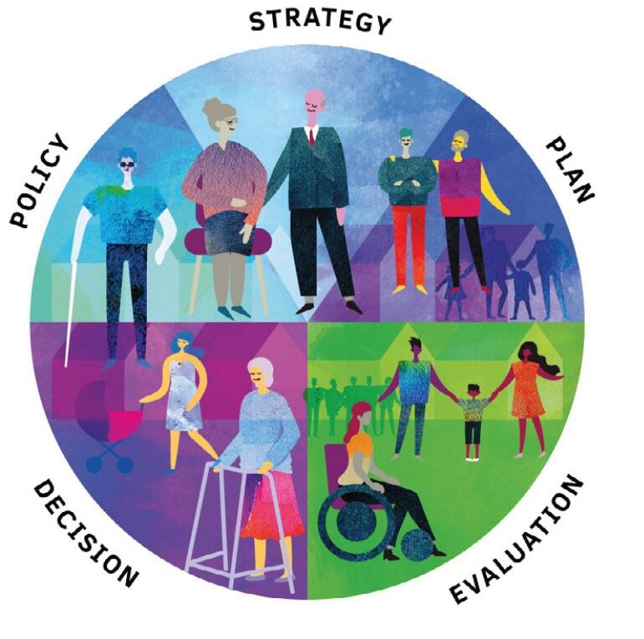
Why this Guide?
Designed to support local consultation and engagement processes
Demand
The views heard from LCDCs, national and local civil society:
Commitment to engage with communities and marginalised groups, but struggling to know how to practically and effectively go about it
Several good sources of principles of consultation and engagement out there but a lack of any ‘how-to’ guideline
LCDCs / local authorities expressed a need for useful tools to help them to put principles for consultation and engagement into practise, with step-by-step adaptable guidance and checklists
Focus on the Practical
Advice on how to translate the principles into practice is brought together from international and local sources, guidance and expert advice and critical input from national and organisations representing marginalised groups. The guide also shares several good local examples as case studies

Slide 7
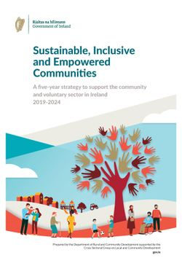
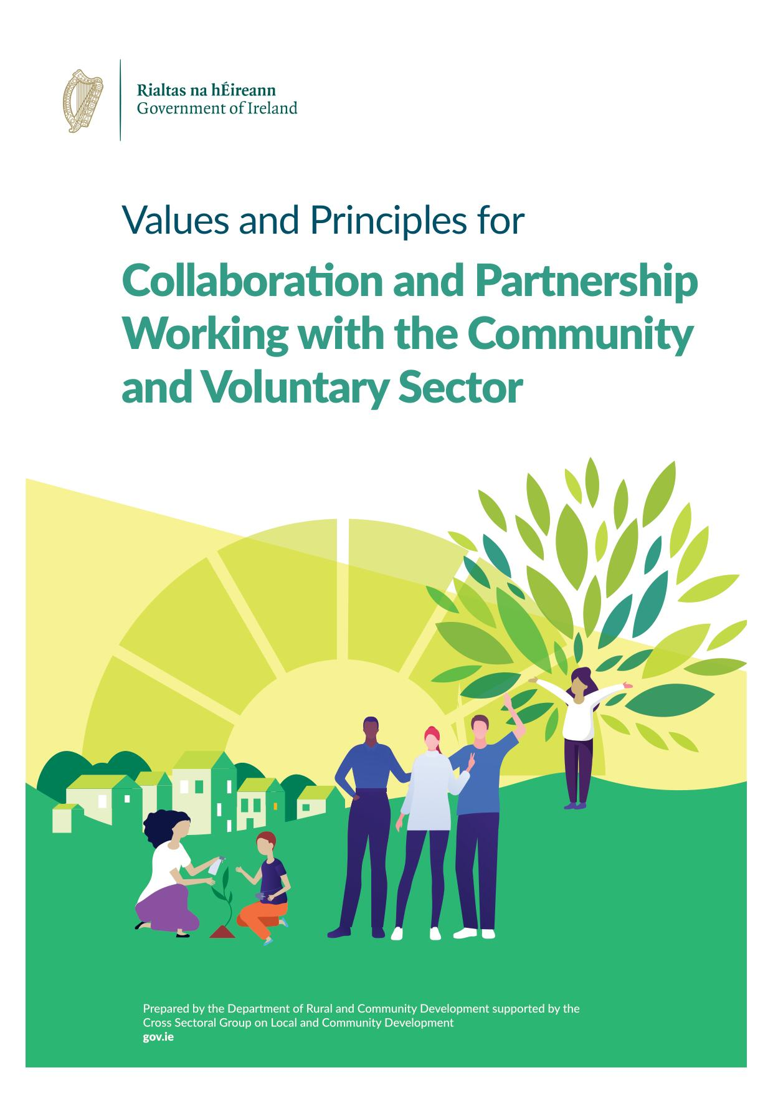
Commitments
A commitment to the principle of Leave No One Behind - critical that policy and planning processes are systematically inclusive of marginalised and disadvantaged communities and their representative organisations have a strong and equal voice
Public bodies – legal Duty to promote equality, prevent discrimination and protect human rights

Slide 8
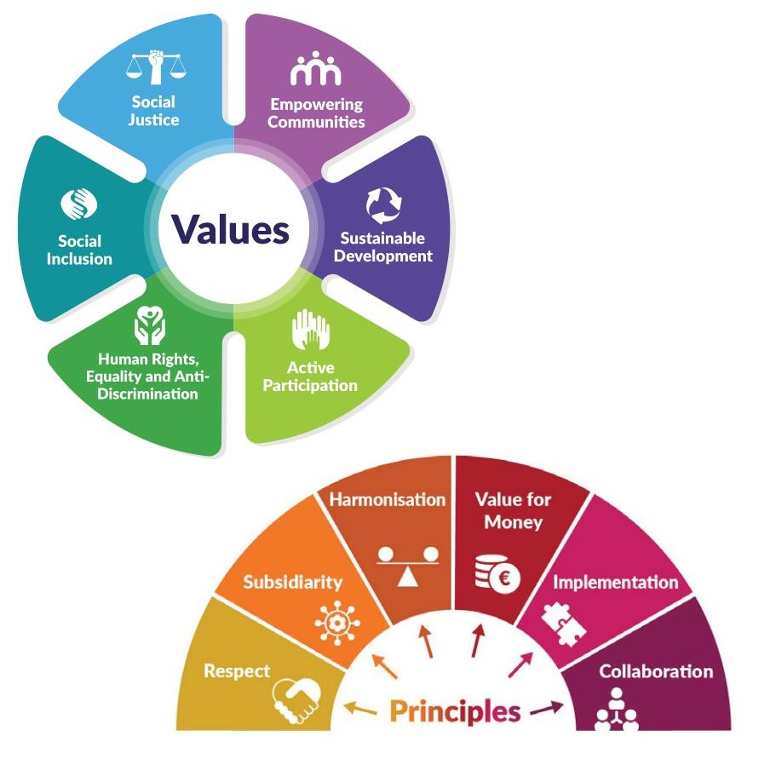
Values-Based Nine principles for inclusive community engagement

Slide 10
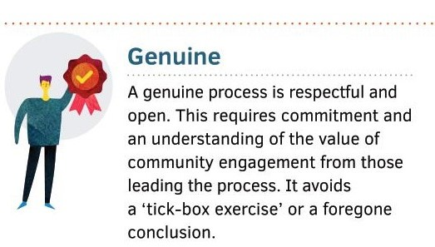

Slide 16
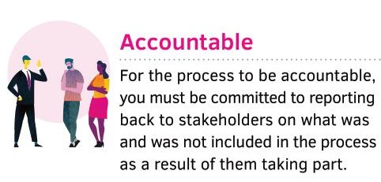

Slide 17
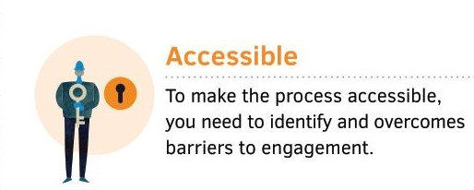

Slide 18
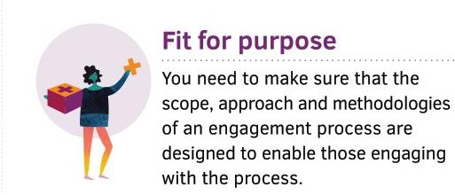

Slide 19
3 Phases, but not a linear process

Slide 21
Secure Commitment
For a successful consultation process that is connected to decision making, leadership and stakeholders must commit to the process and treat it with respect. You should not assume that this is so.
A genuine engagement
When local outcomes or services are improved as a result of the engagement process, this enhances faith in the process. However, when consultation exercises are poorly focused, rushed or superficial, they may create mistrust, waste people’s time and money and undermine future attempts at public engagement.
Involve: People and Participation, How to Put Citizens at the Heart of Decision Making. (www.involve.org.uk)

Slide 22
Building Relationships
Invest in relationships with community and representative organisations
Get their advice on how and who to consult with
Process – not an event

Slide 23
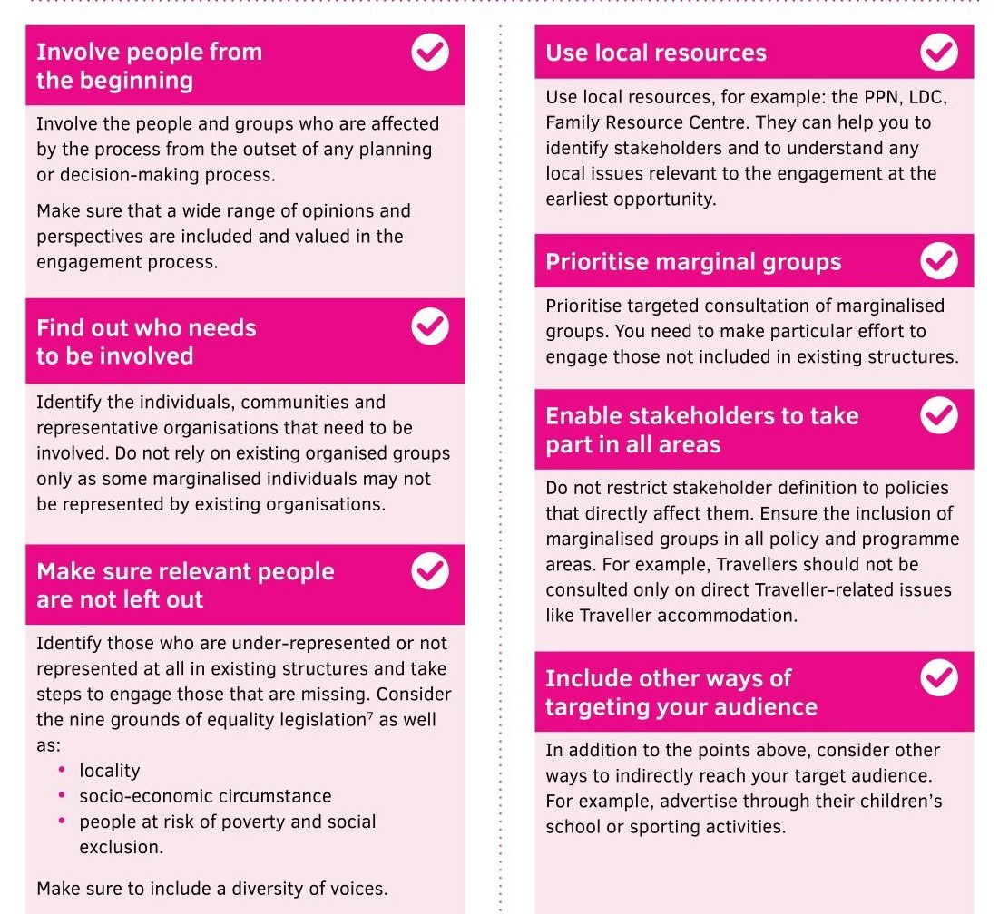
Identify stakeholders and reach out

Slide 24
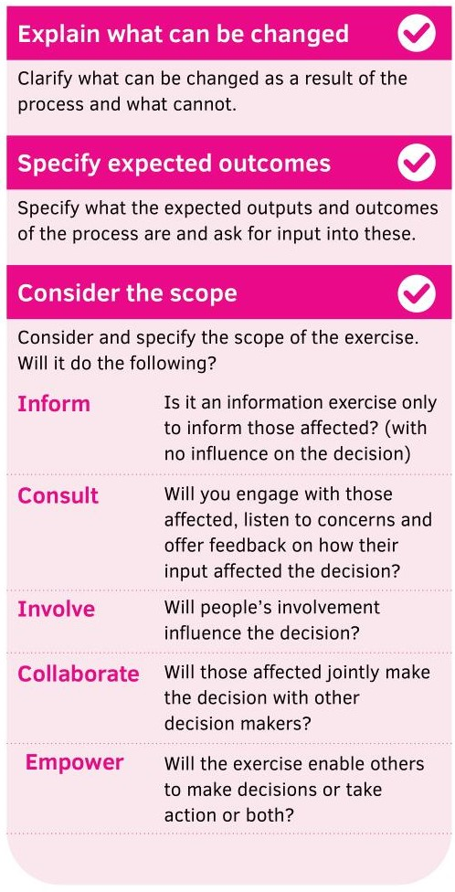
Clarify Clarify the purpose, scope and framework of the process Communicate it clearly

Slide 25
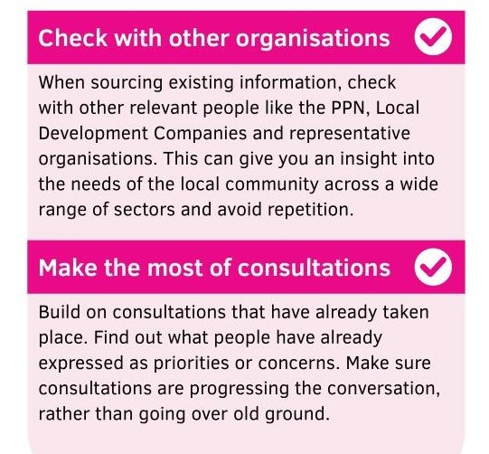
Find out… what has been asked before

Slide 26
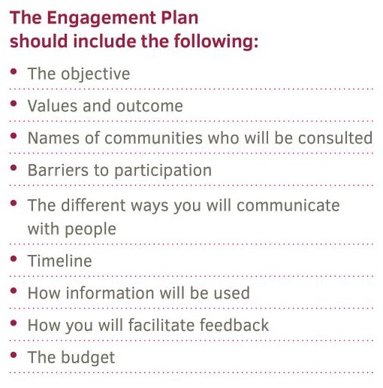
Co-design...
an engagement plan
Collaboratively – taking account of time, skills and other resources An engagement plan should be a living document with built-in flexibility for unforeseen circumstances, for example, adapting engagement to a virtual format during the COVID-19 pandemic.
An engagement plan should be a living document with built-in flexibility for unforeseen circumstances

Slide 27
Barriers to Participation
Mitigation
Inconvenient meeting times for your target audience
Inaccessible locations
Communication
Care Responsibilities
Transportation
Inadequate notice
Costs
Lack of confidence or capacity
Cultural or social norms
Technology skills
Social Isolation
Past disappointment
Relationship history
Hold meetings at a variety of times
Advertise in a variety of ways
Ensure all venues are fully accessible
In-person and on-line opportunities
Sign language interpretation
English language interpretation
Cover costs
Address power imbalances

Slide 28
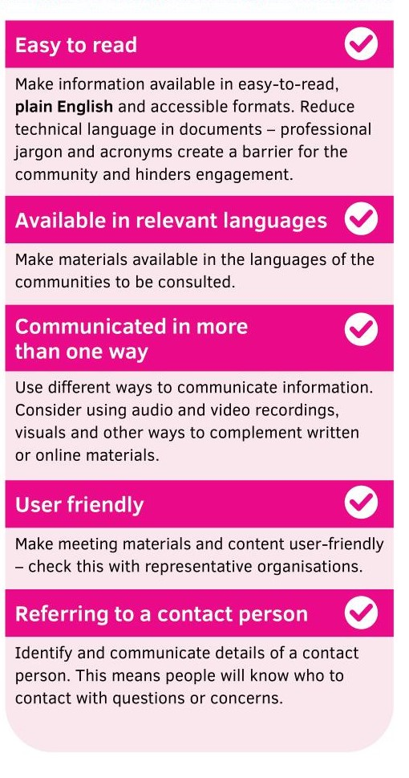
Develop materials… that are

Slide 30
Communicate…
in a way that attracts attention.
Communicate news of an upcoming community engagement process in a way that actively encourages all stakeholders to take part. If you want to remove barriers to people taking part, make it clear to them how they can get involved.

Slide 31
Getting people involved…
Focus Groups /Roundtables….
build relationships
achieve active engagement
participation
Surveys/Submissions….
Maybe off putting
Help people with formal processes
Include marginalised groups

Slide 33
Feedback
Verification
What is going to happen as a result of people giving you their information
Explain
what is to be included
What is not
why
Lack of feedback – frustration and disillusionment
You said….we heard
Send a draft and allow comments
Reflect with stakeholders on how the process was
Could it be improved?

Slide 34
Principles into action – how do you know???

Slide 35
Engagement Checklist: to use at the outset of any new planning or decision-making process
Planning Phase
Purpose
Affected people informed
Implementation Phase
Advance Information
Accessibility Supports for travel / time / locations
Review Phase
Verification
Contacts made
Engagement Plan developed
Communications
Barriers identified
Budget secured
Communication
Materials distributed
Competent facilitation
Language and interpretation
Feedback recorded
Feedback to communities
Next steps determined and communicated
Reflection on the process and outcomes

Slide 36
Discussion
Clarifications
Anything you would use?
Any good examples?
Any bad examples?
What would be useful in the future?
Continuous Practice Development?
Review - https://www.surveymonkey.com/r/InclusiveEngagementWkReview
Community Work Ireland – www.cwi.ie
New members welcome!!

Slide 37
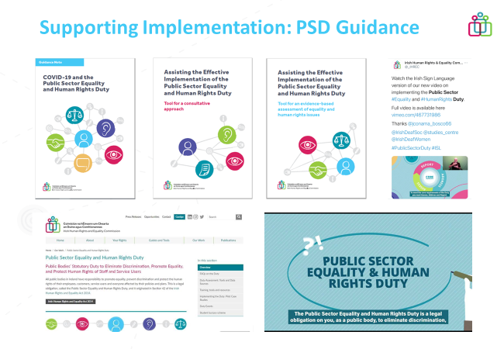
Resources – click on the images

Slide 38
Take-aways
Make people comfortable
De-formalise spaces
Be creative
Use humour
Get them talking
Food
SMILE
Remember Task & Process
You need to accomplish the task but the way you do it creates the conditions for buy-in, ownership and future participation

